Slide 1


SAVE OUR FOOD!
Lesson 1
KS1/P2-4/Y1-3

Slide 2
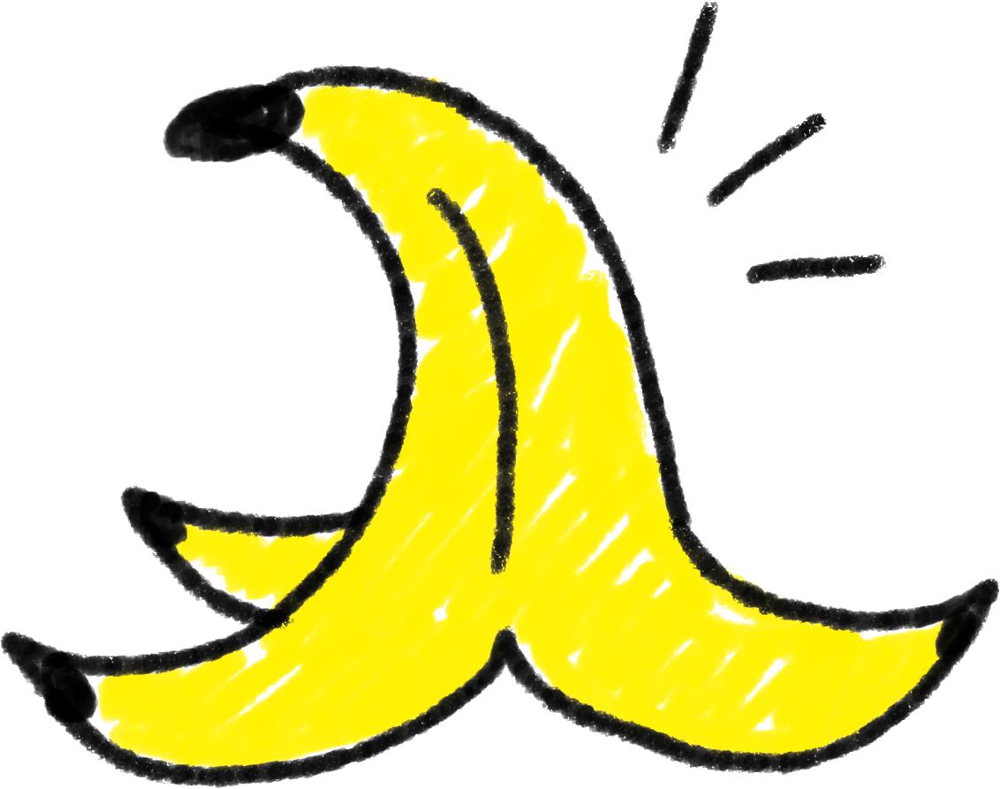
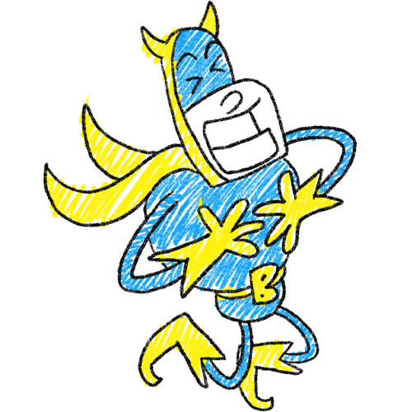
Why do monkeys like bananas?
Because they have a-peel!

Slide 3
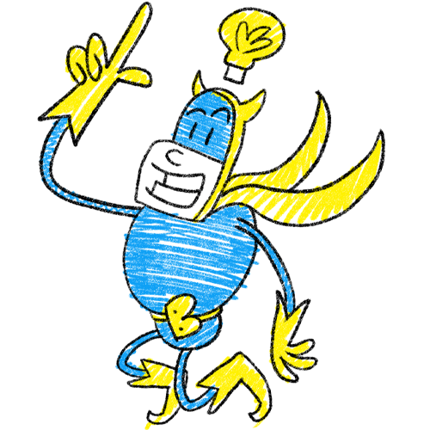
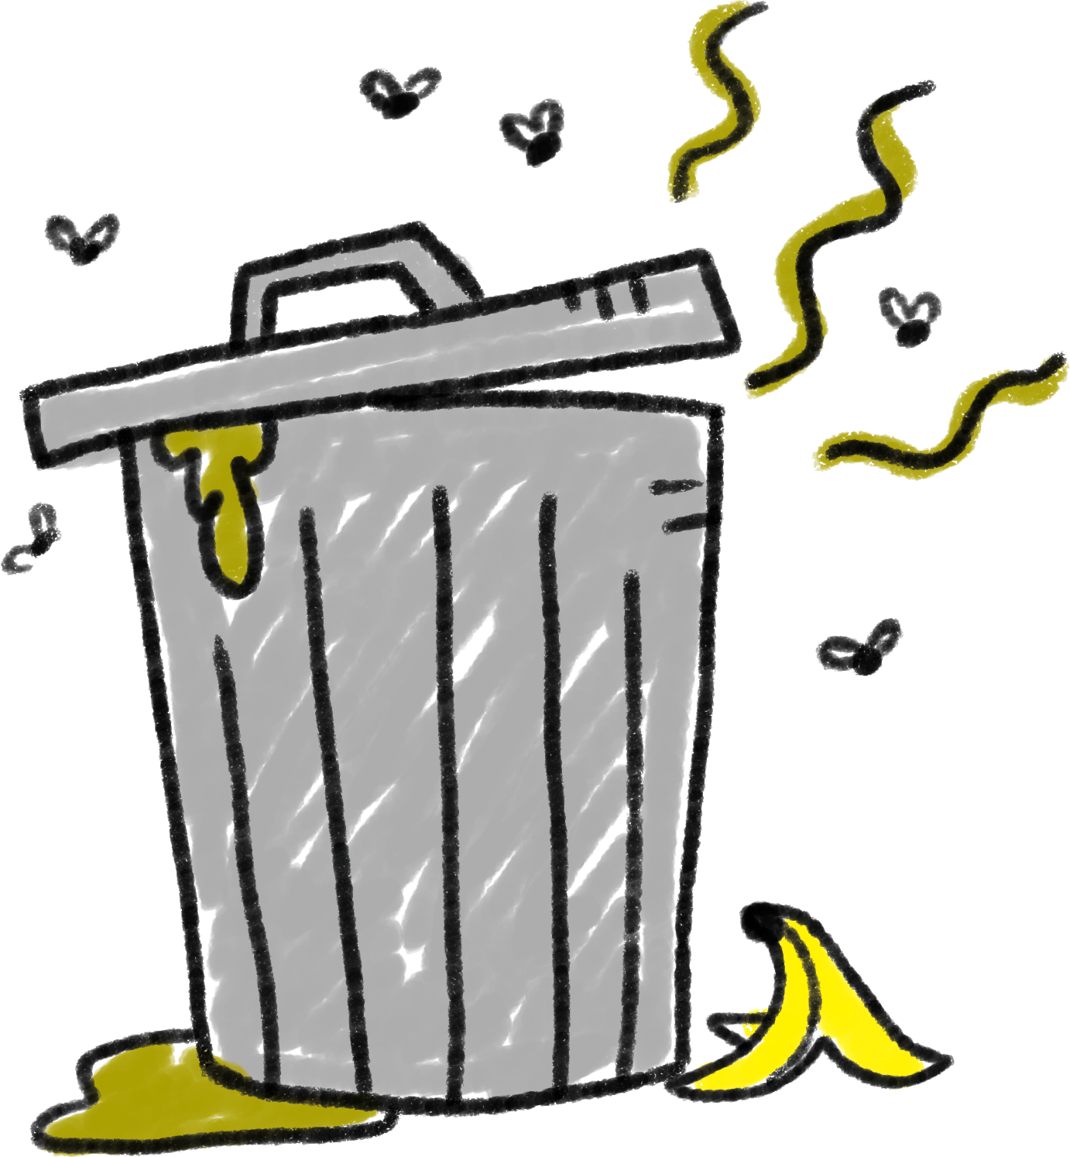
The finest of fruits is in danger… and I, BANANAMAN, Beanotown’s best fruit-based superhero, am on a mission to save them… from the BIN!
Will you join me in my noble
(and possibly stinky) quest?

Slide 4
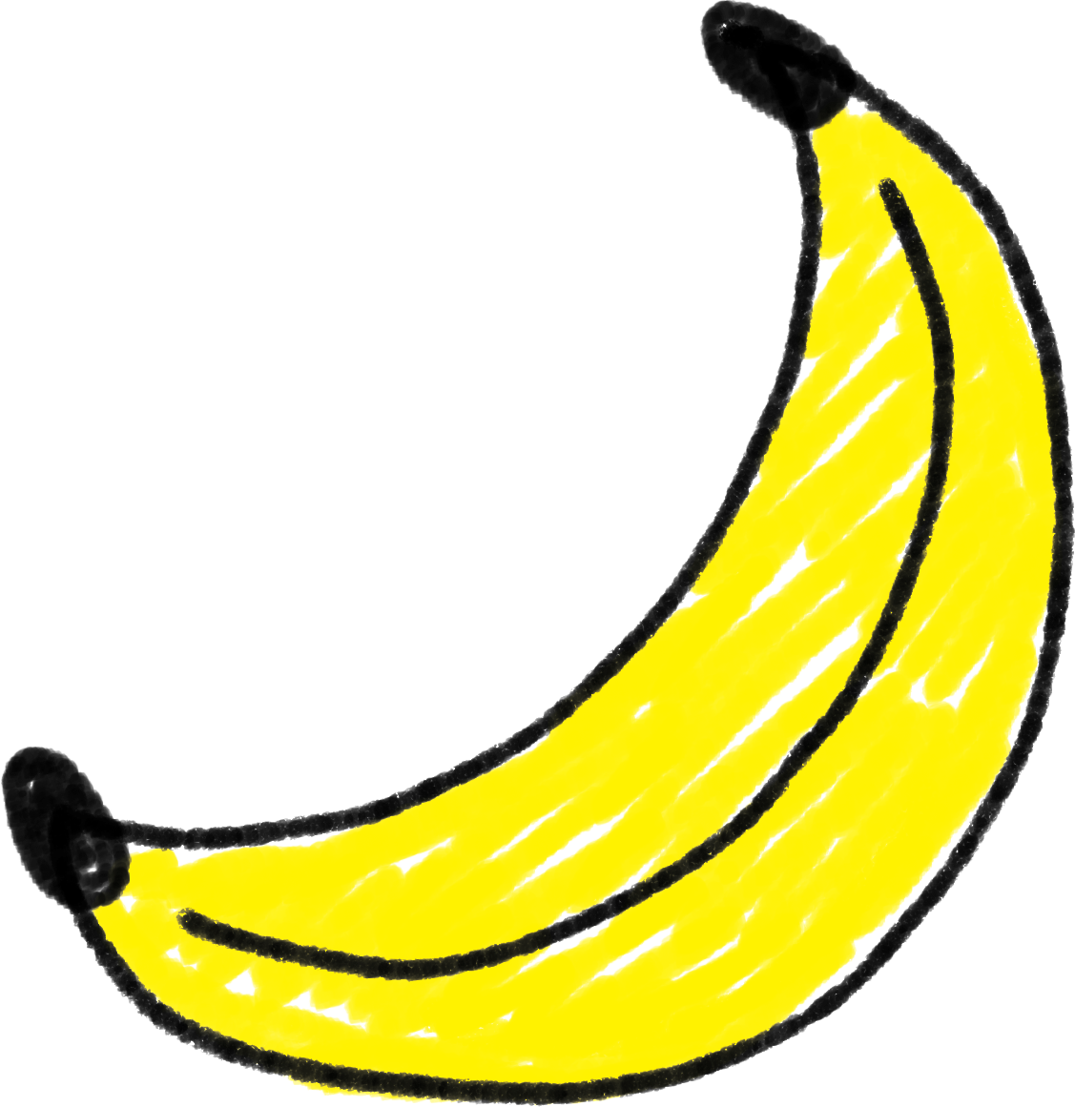
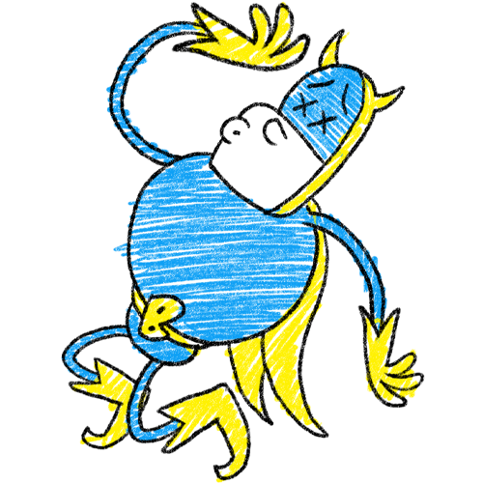
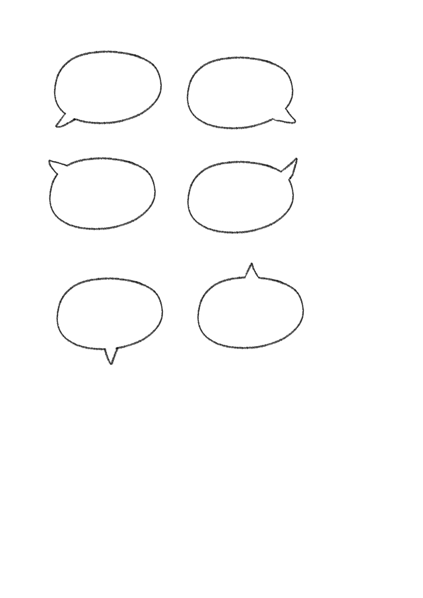
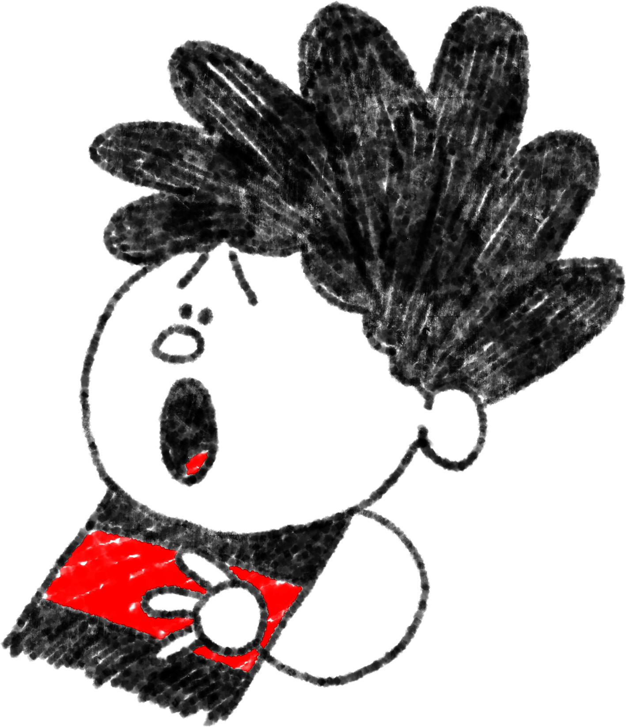
In the UK, we throw away
920,000
whole bananas every day!
But it’s not just bananas, Bananaman!

Slide 5
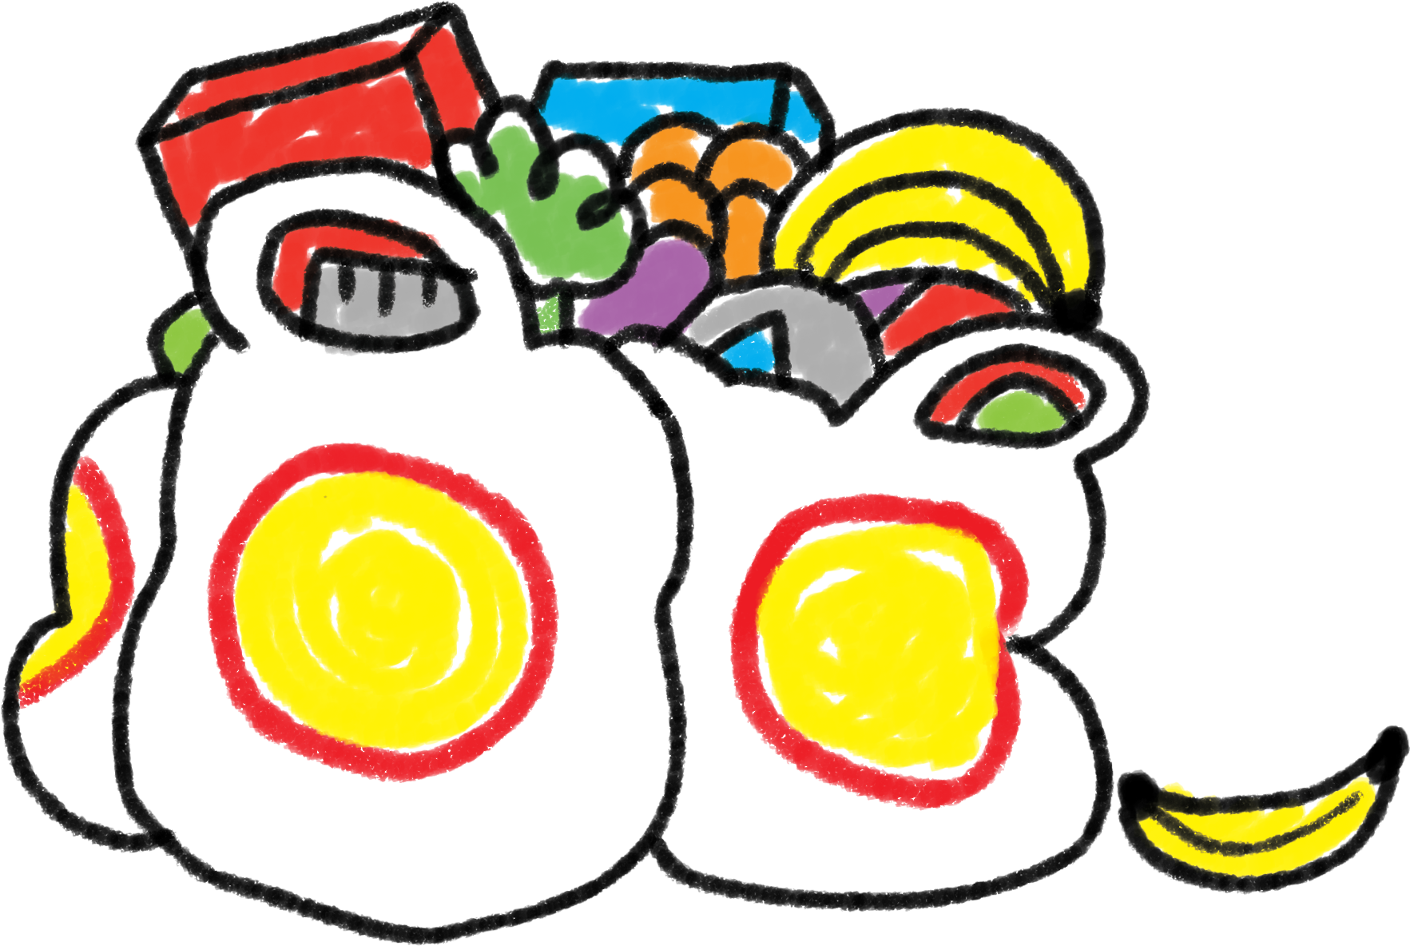
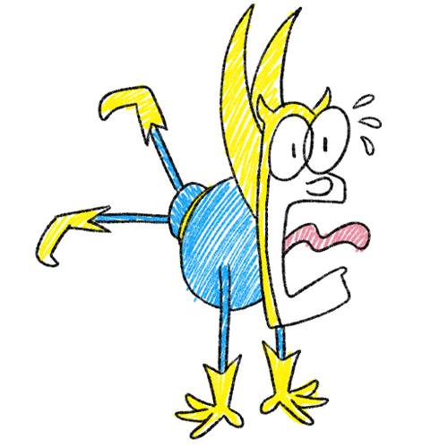
Each year, about one third of all food produced for human consumption in the world is lost or wasted.
That’s like buying three bags of shopping and chucking one straight in the bin! Utterly bananas!
Notes:
Food wastage footprint: Impacts on natural resources - Summary report: https://www.fao.org/3/i3347e/i3347e.pdf

Slide 6
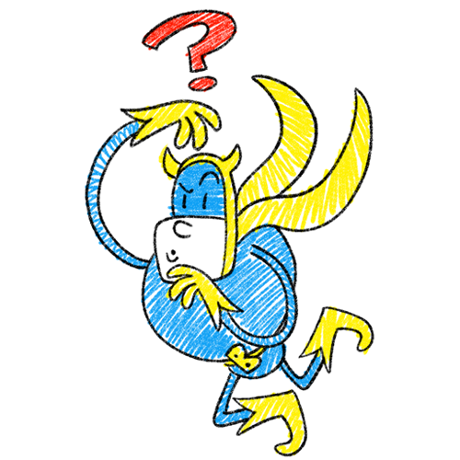
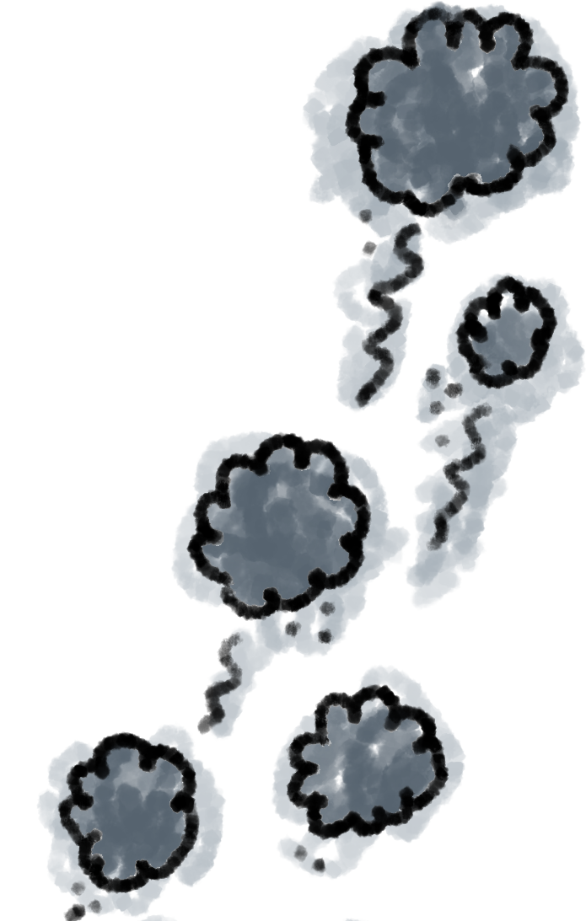
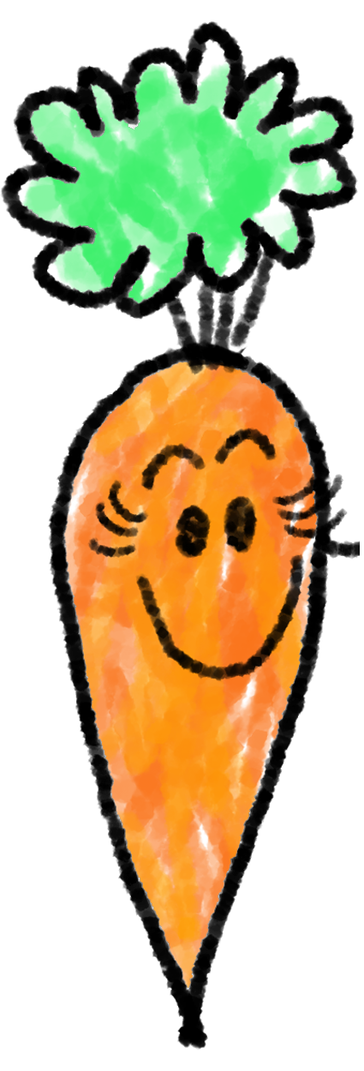
’Food Waste’
is any food that is not eaten.
(including things like shells and skins!)
This stinks… and sounds really bad for the environment.
Globally, most of the food we throw away ends up in landfill
(places where rubbish is kept – usually big holes dug in the ground).
As food rots it releases gases that are warming up our planet and making it harder for animals, plants and humans to live on it.

Slide 7
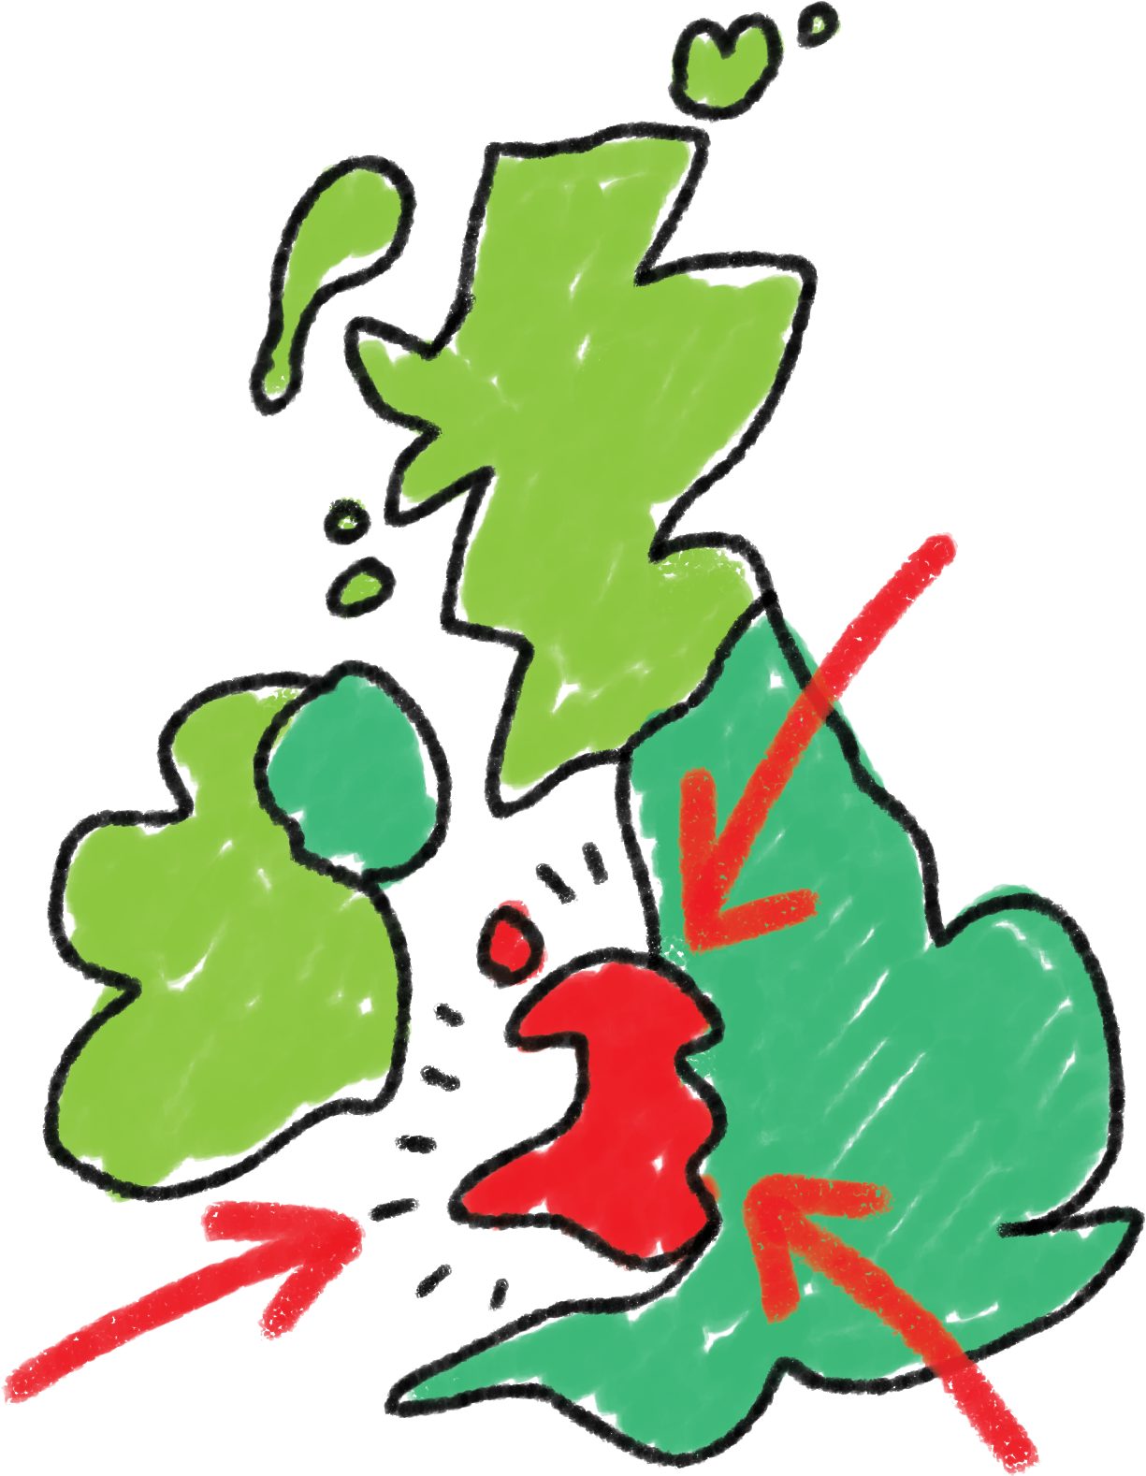
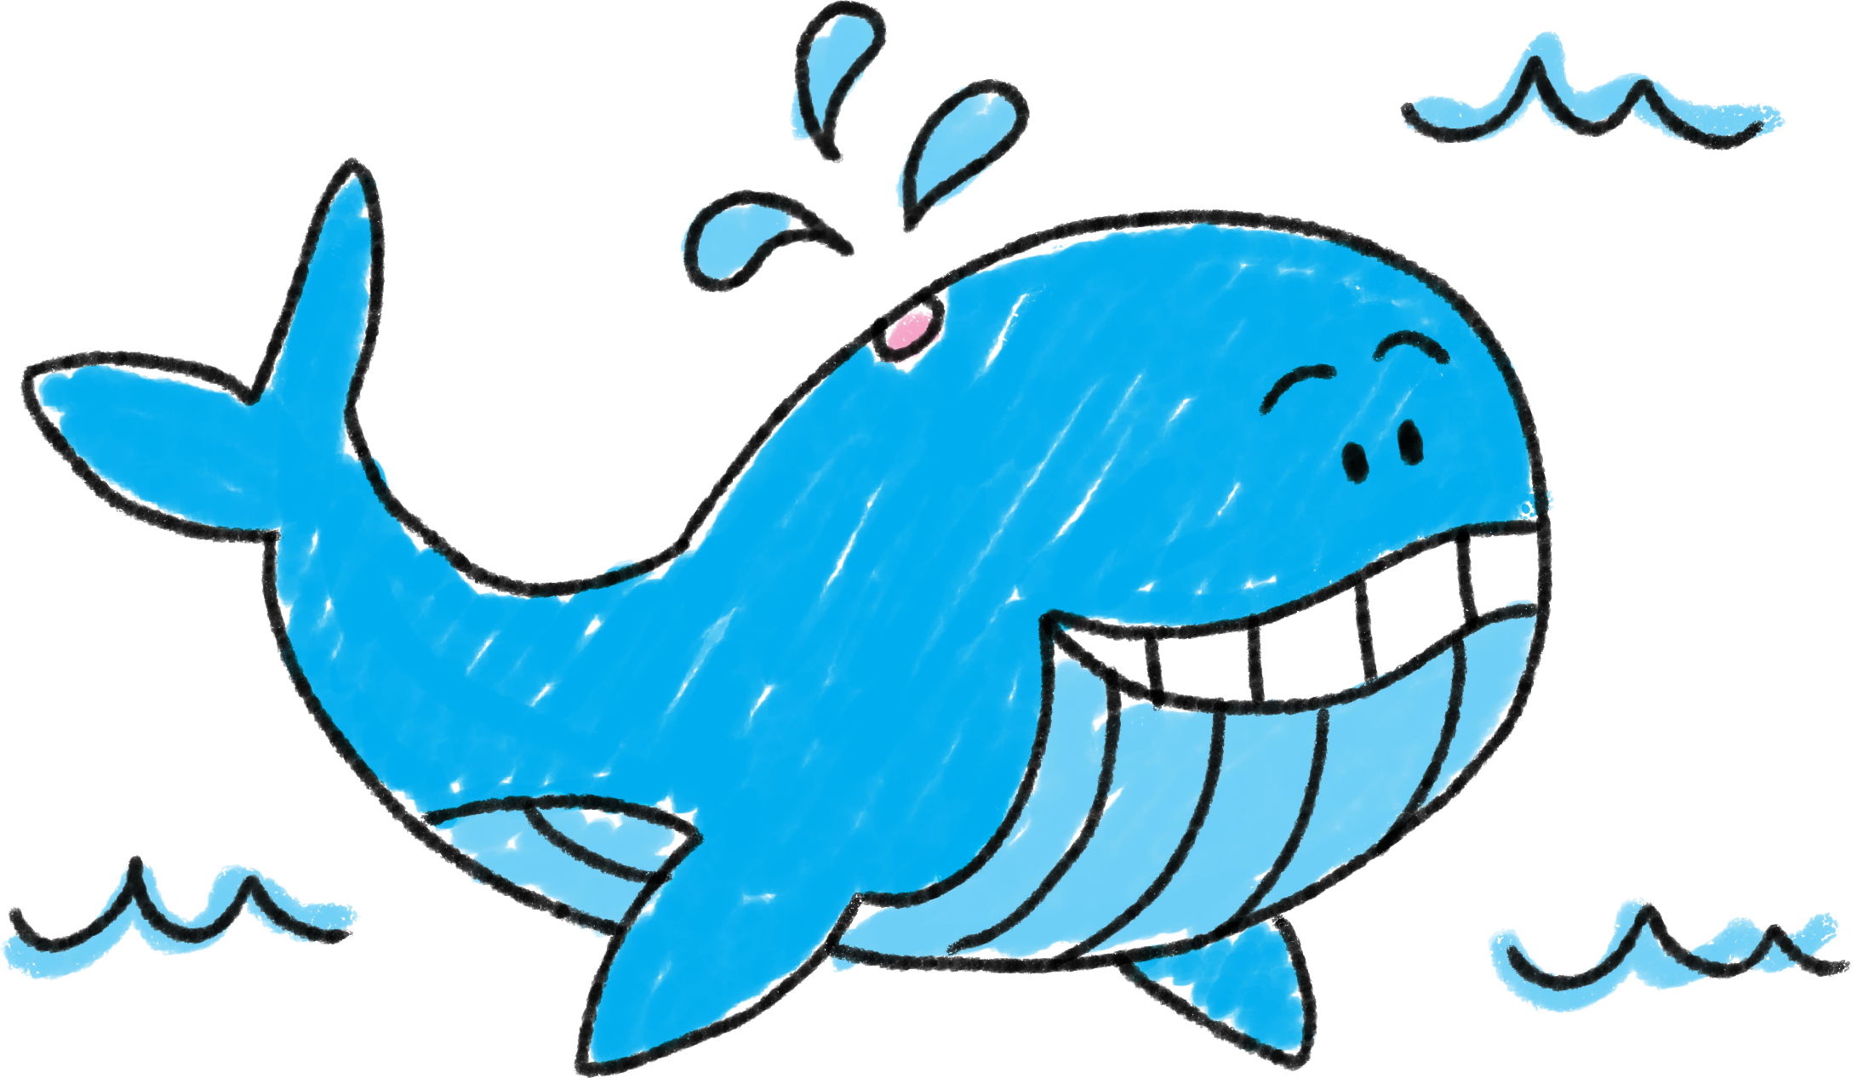
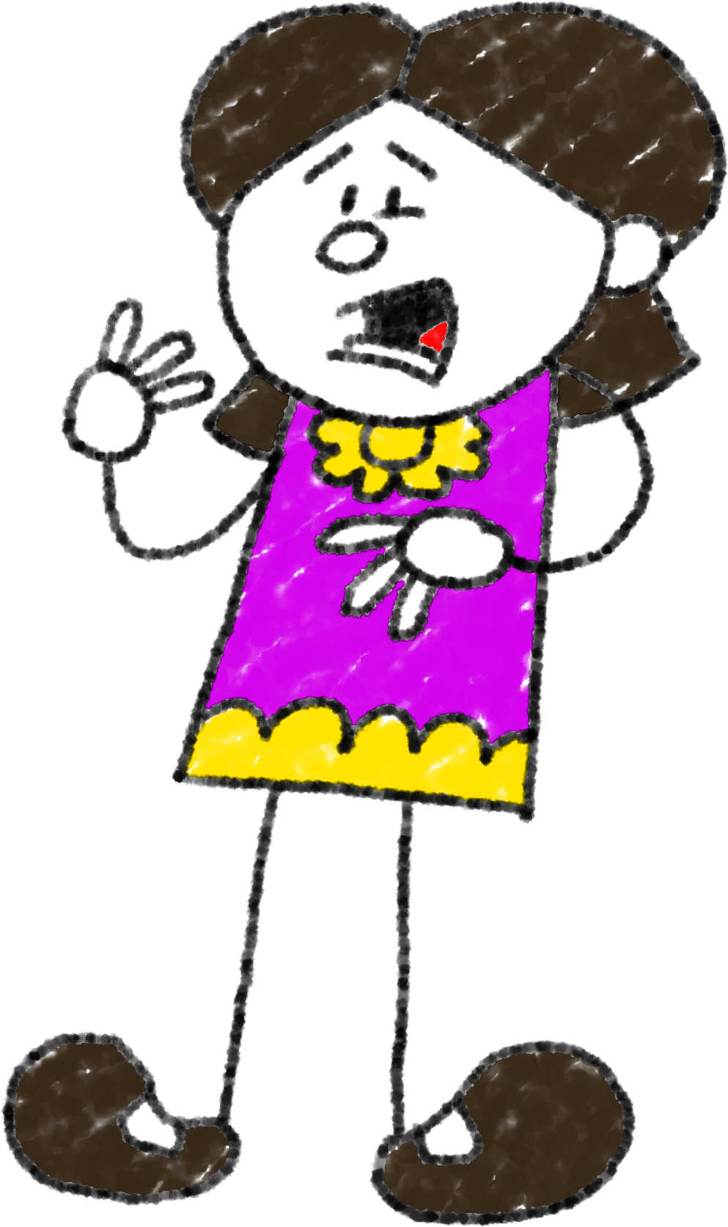
Where are whales weighed?
At the whale-weigh station!
It requires an area almost the size of Wales to produce all the food and drink currently wasted in the UK.
That’s a whal-ey big problem!

Slide 8
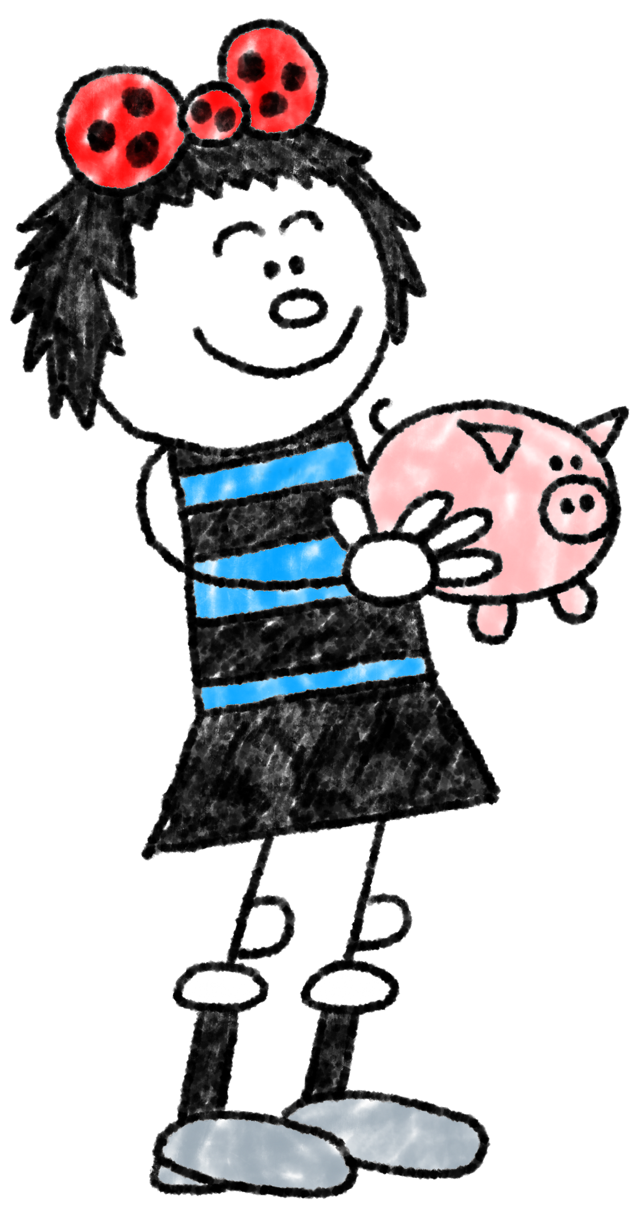
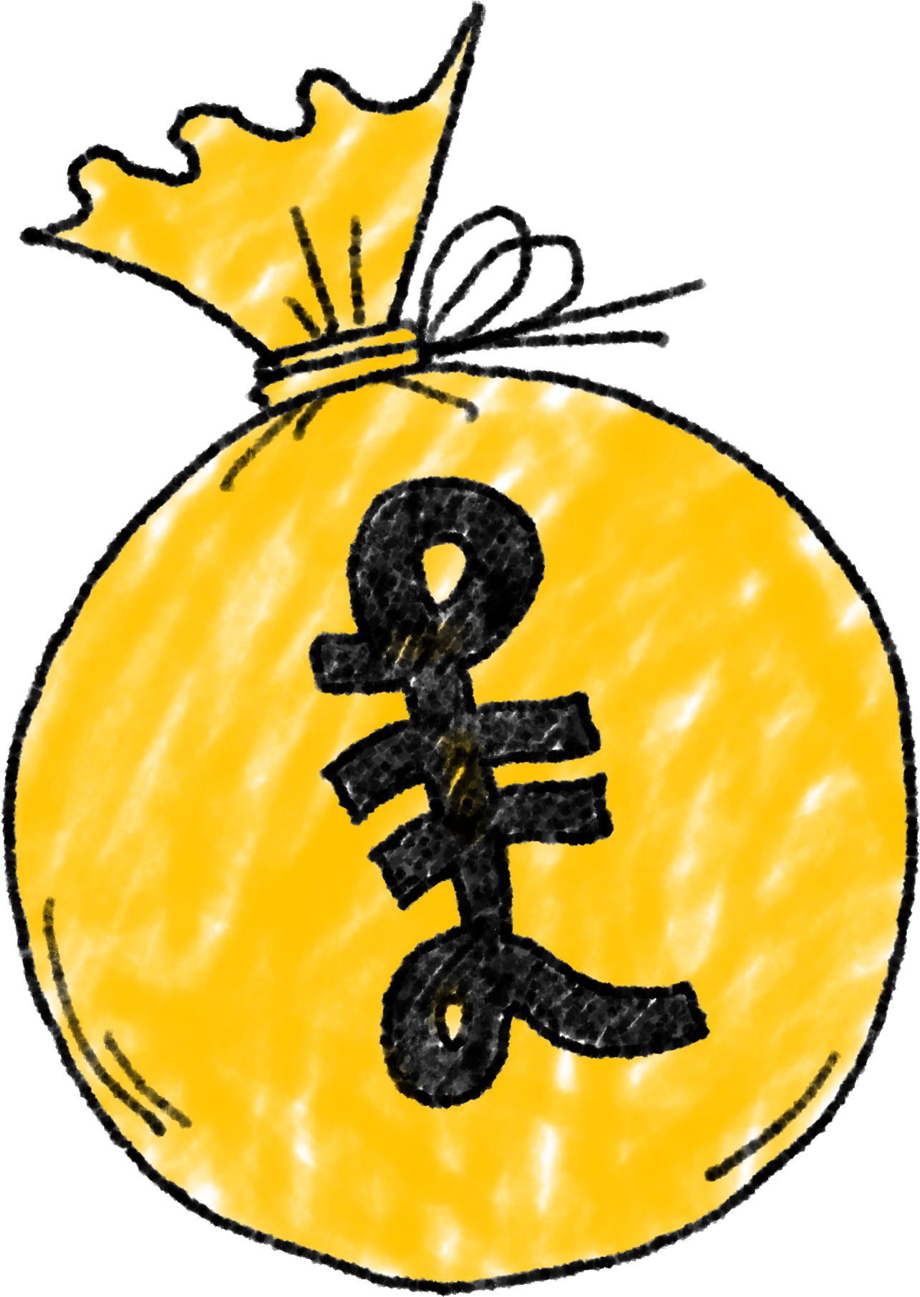
We throw away 6.6 million tonnes of household food waste a year in the UK.
Most is food that could have been eaten and is worth approximately
£14 billion
That’s roughly £14 a week or £60 a month for an average family with children.
What would you do with that money?!

Slide 9
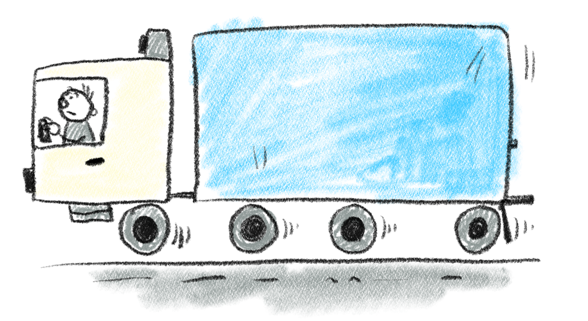
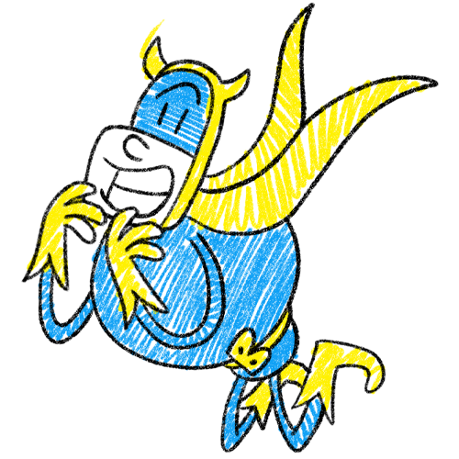
But even worse, throwing food away means all the natural resources that went in to growing, transporting, packaging and selling the food is wasted too!
Look at the cards on your tables. In your group, try to put them in order to show the effort that goes into producing the food we eat.
Ooh, ooh! Can you guess which food I chose for you to look at?!

Slide 10
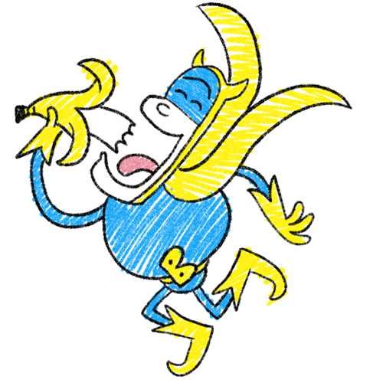
Let’s follow the
Yellow Fruit Road!
Look at the amounts of effort, time, resources and money that go into getting those magnificent bananas into my, err… our hands!

Slide 11
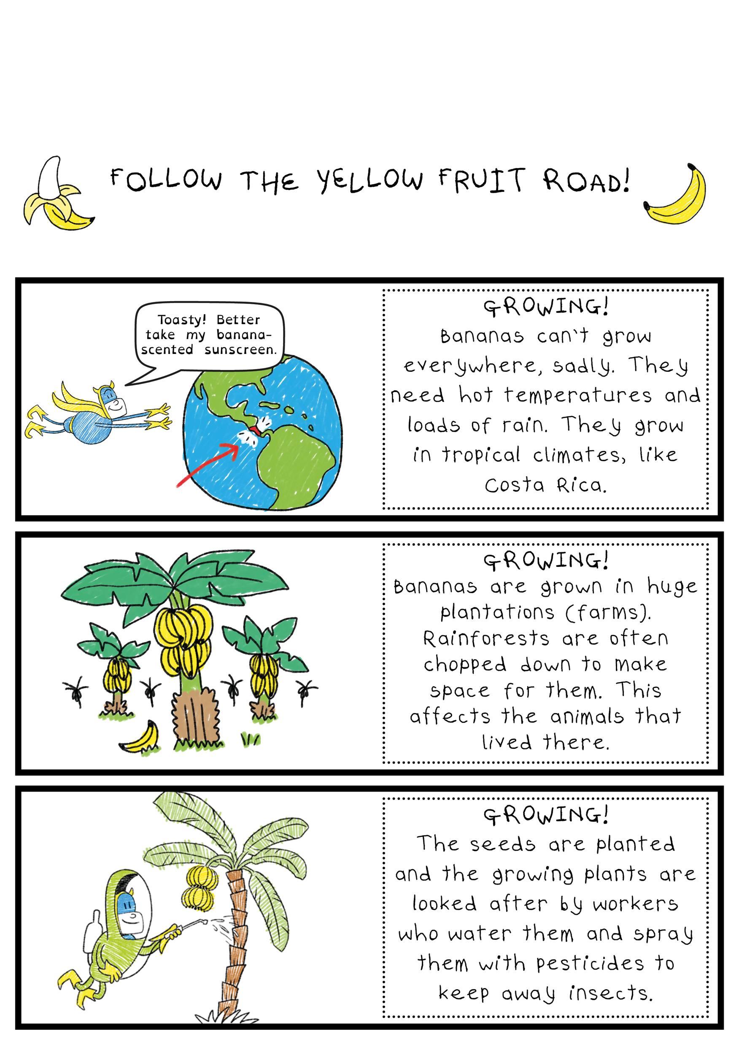

Slide 12
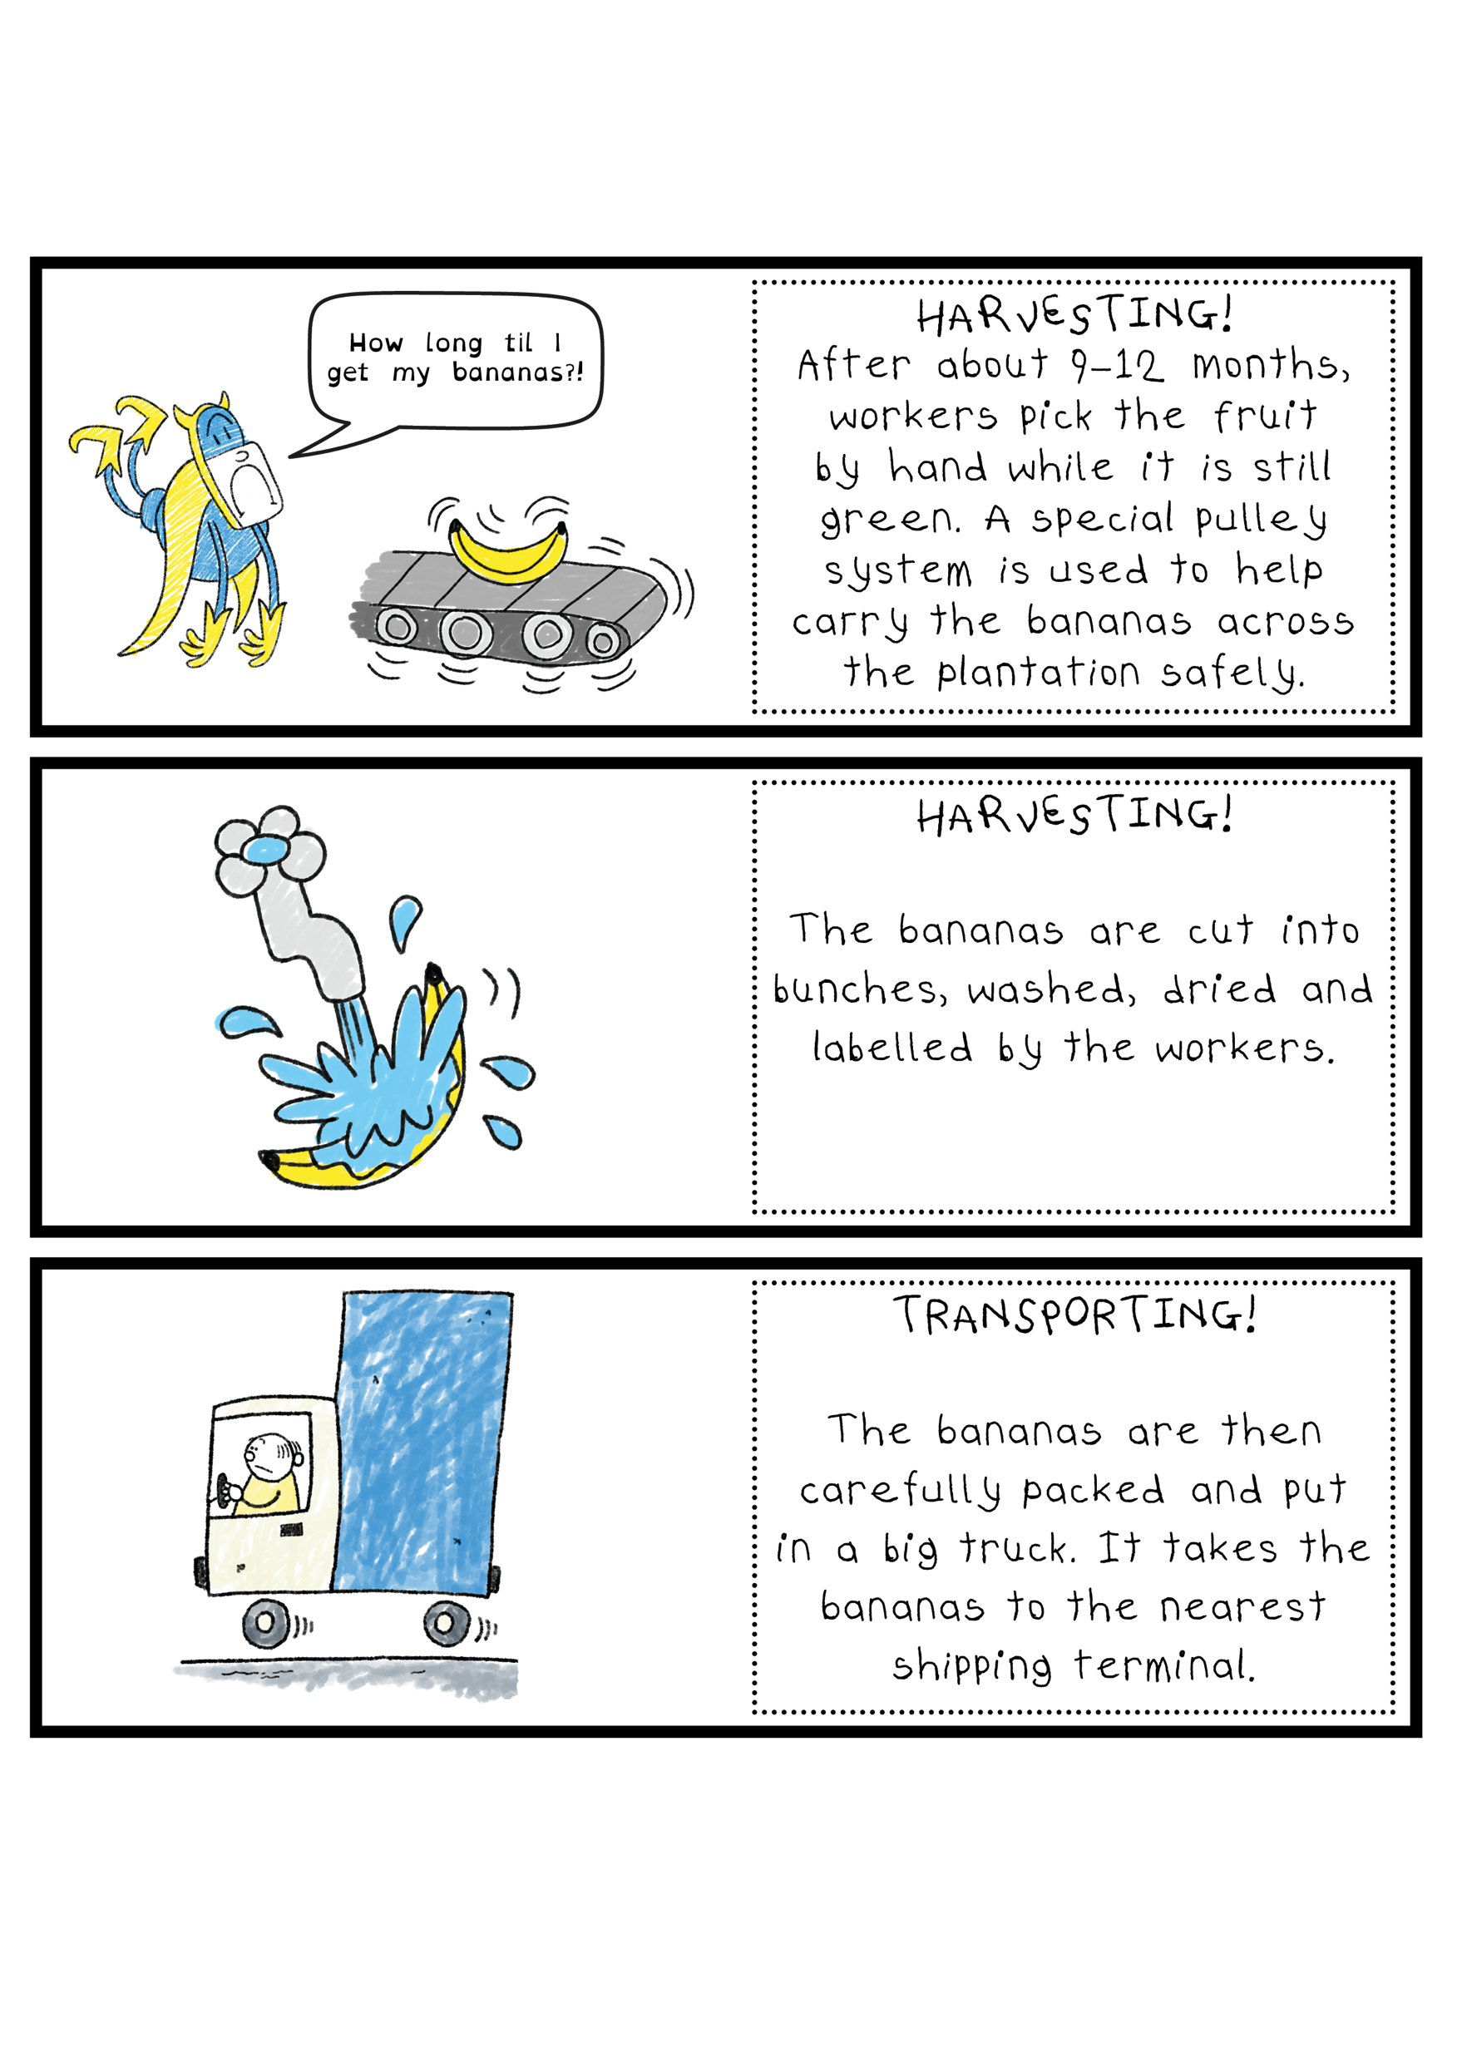

Slide 13
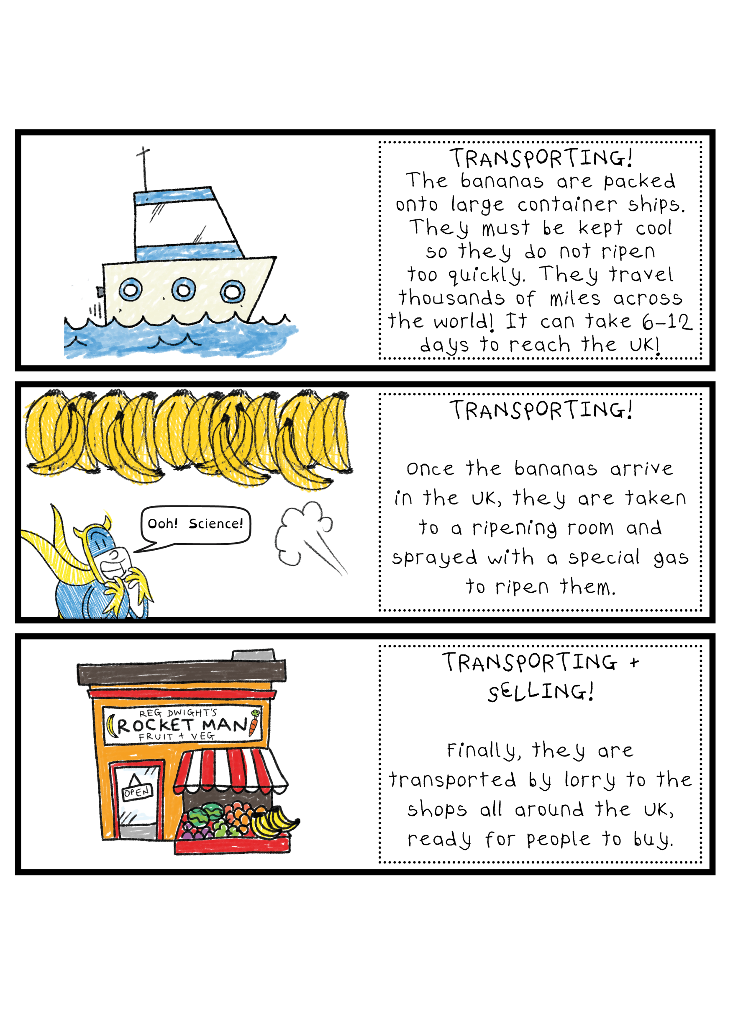

Slide 14
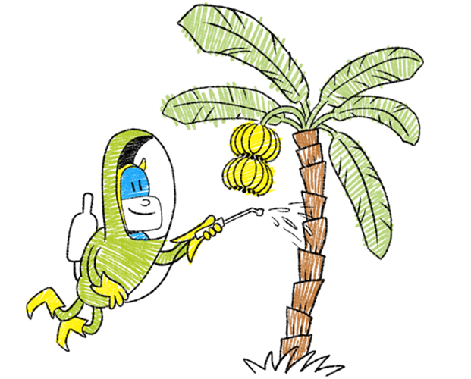
Bananafact!
Did you know a single banana is called a “finger” and what we usually call a bunch is actually called a “hand”?
A "bunch" is made up of lots of hands of bananas, and that's how they come off the tree!

Slide 15
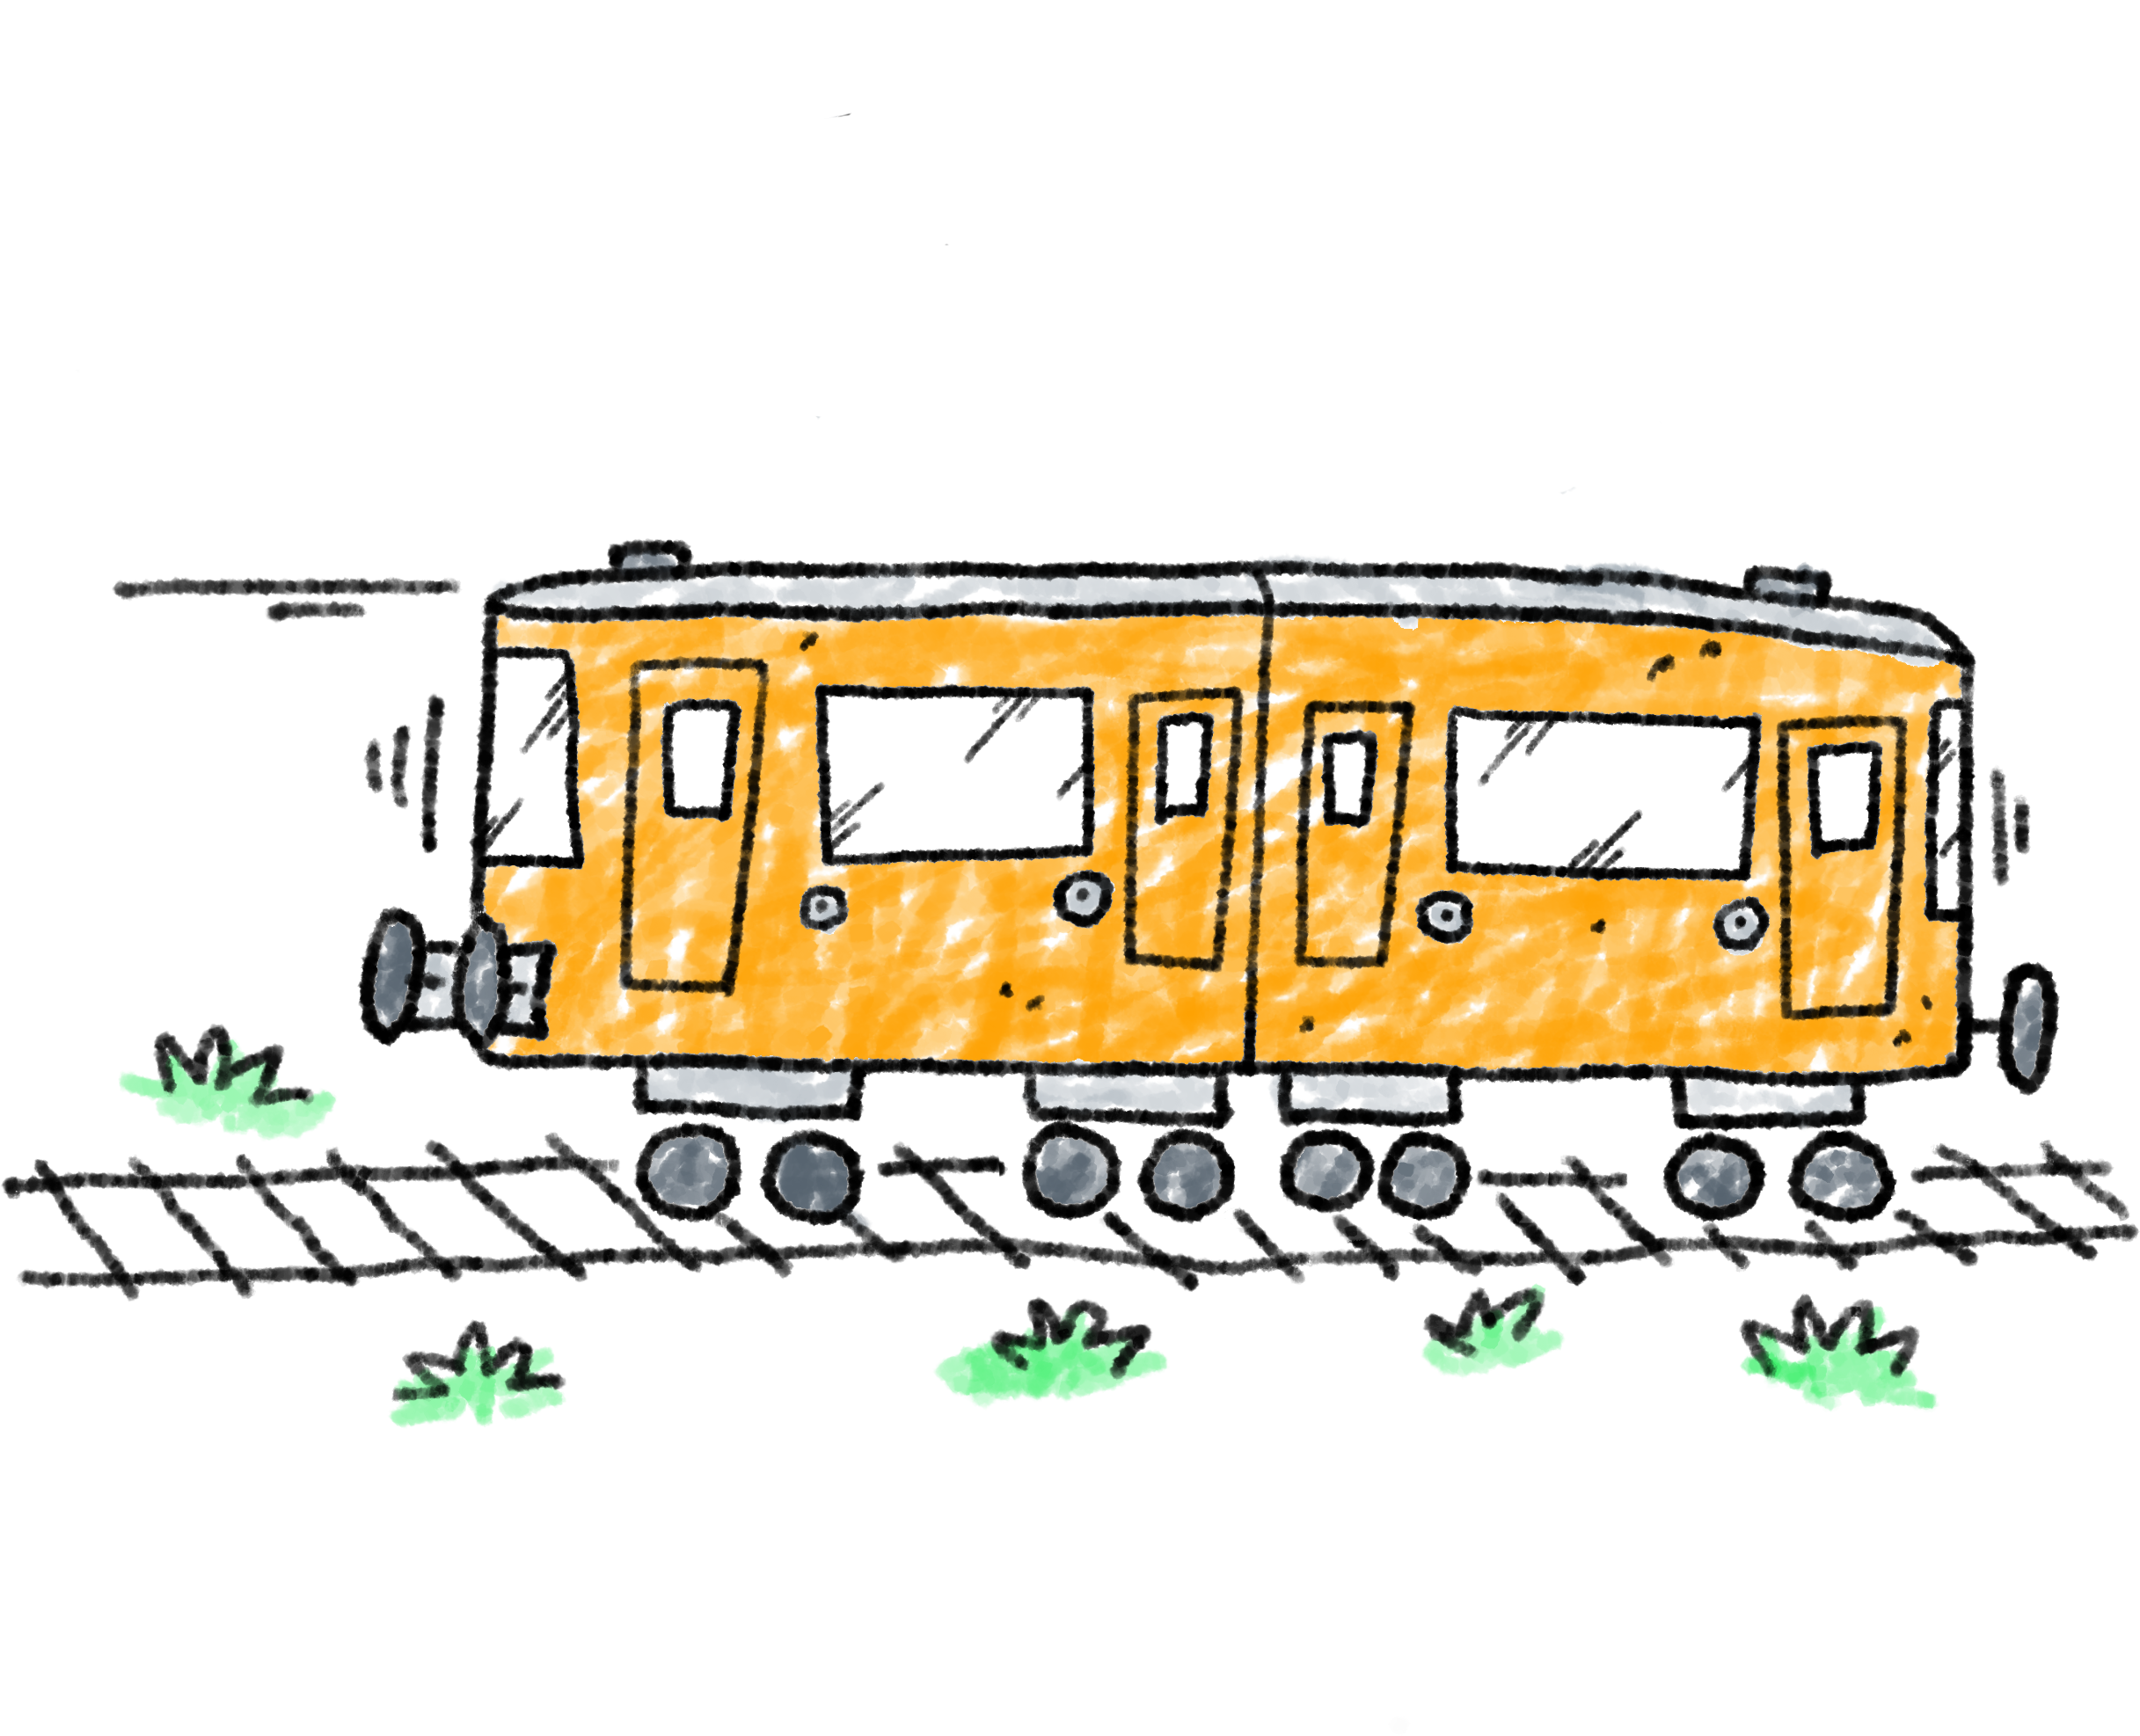
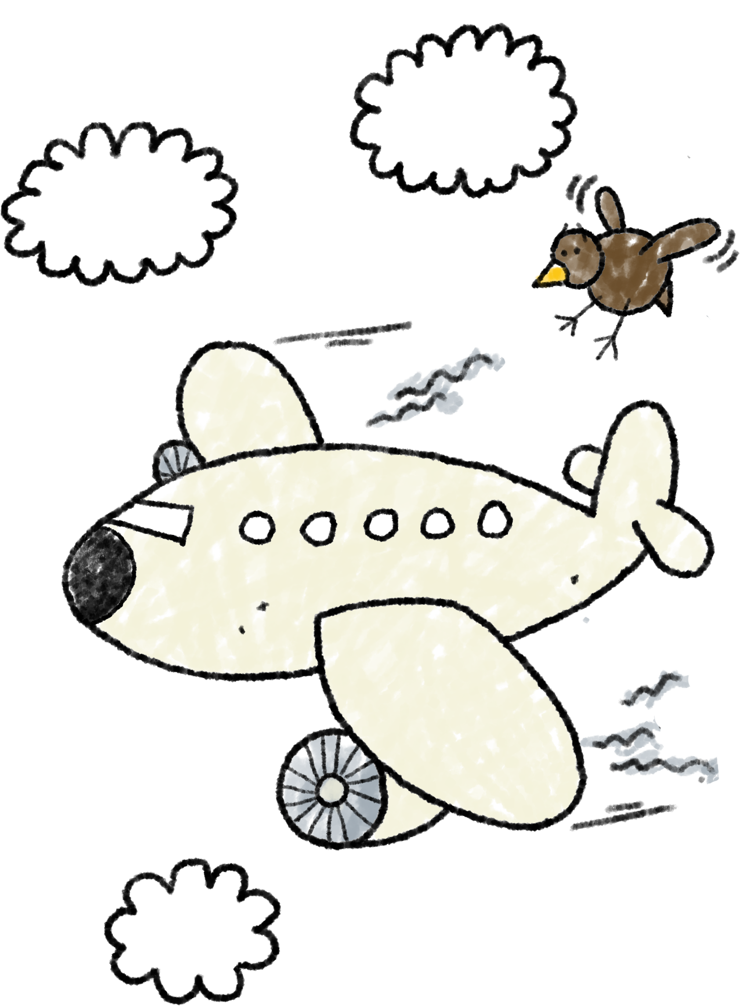
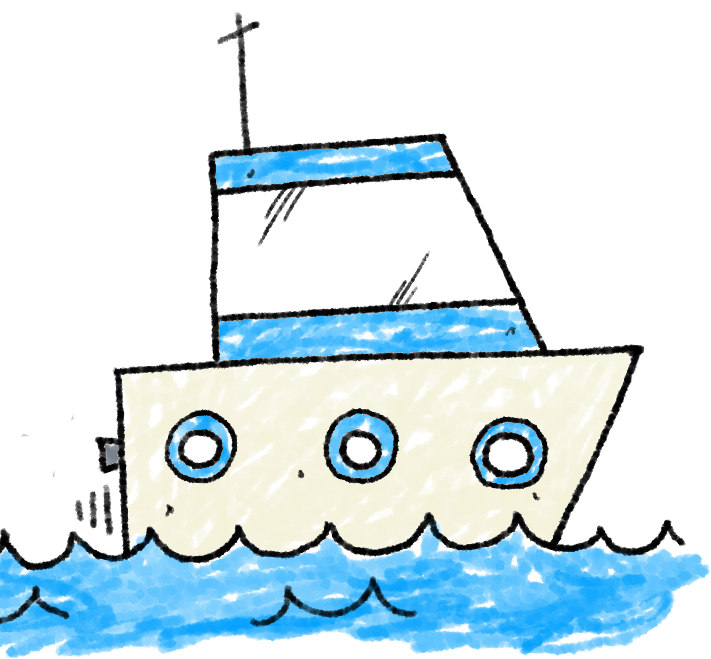

Food waste has a huge impact on our planet:
1. Loads of effort goes into getting food from the land to our hand - making food uses energy, natural resources and processes (farming, transporting, packaging etc) that are bad for our environment.
2. By then chucking it in the bin, we have not only wasted all those resources but we also create yet more harmful gases that contribute to global warming and climate change.
Food waste is doubly damaging.
WE MUST STOP WASTING FOOD!
But how?

Slide 16
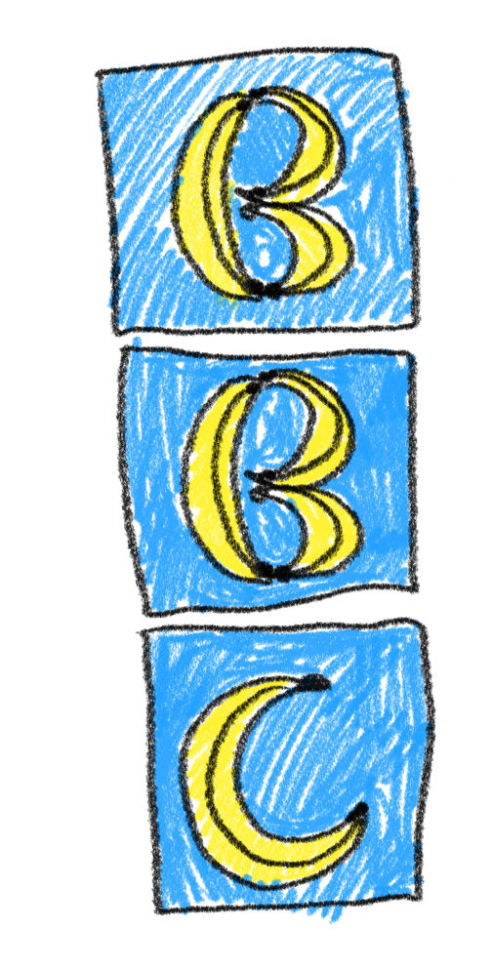

You’re now part of the
Bananaman
Broadcasting
Corporation!
Your mission will be making a special poster to tell others in your school about the importance of not wasting bananas food.
What information will you include to grab people’s attention?
How will you make your message stand out?
Your posters might be displayed at school for everyone to see, or might even be sent to Beano’s Editor to be displayed on their website for the whole world to see!

Slide 17
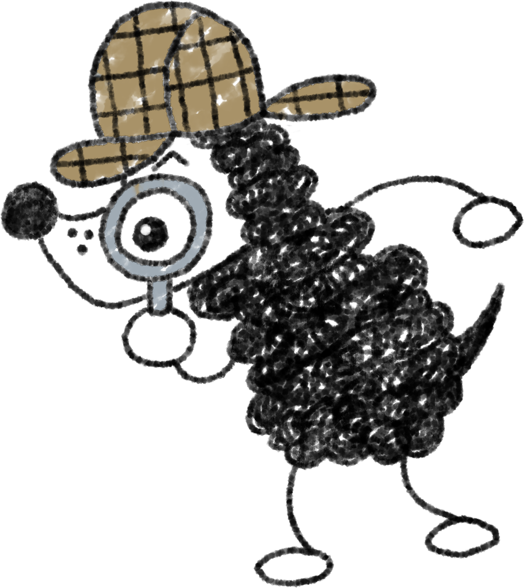
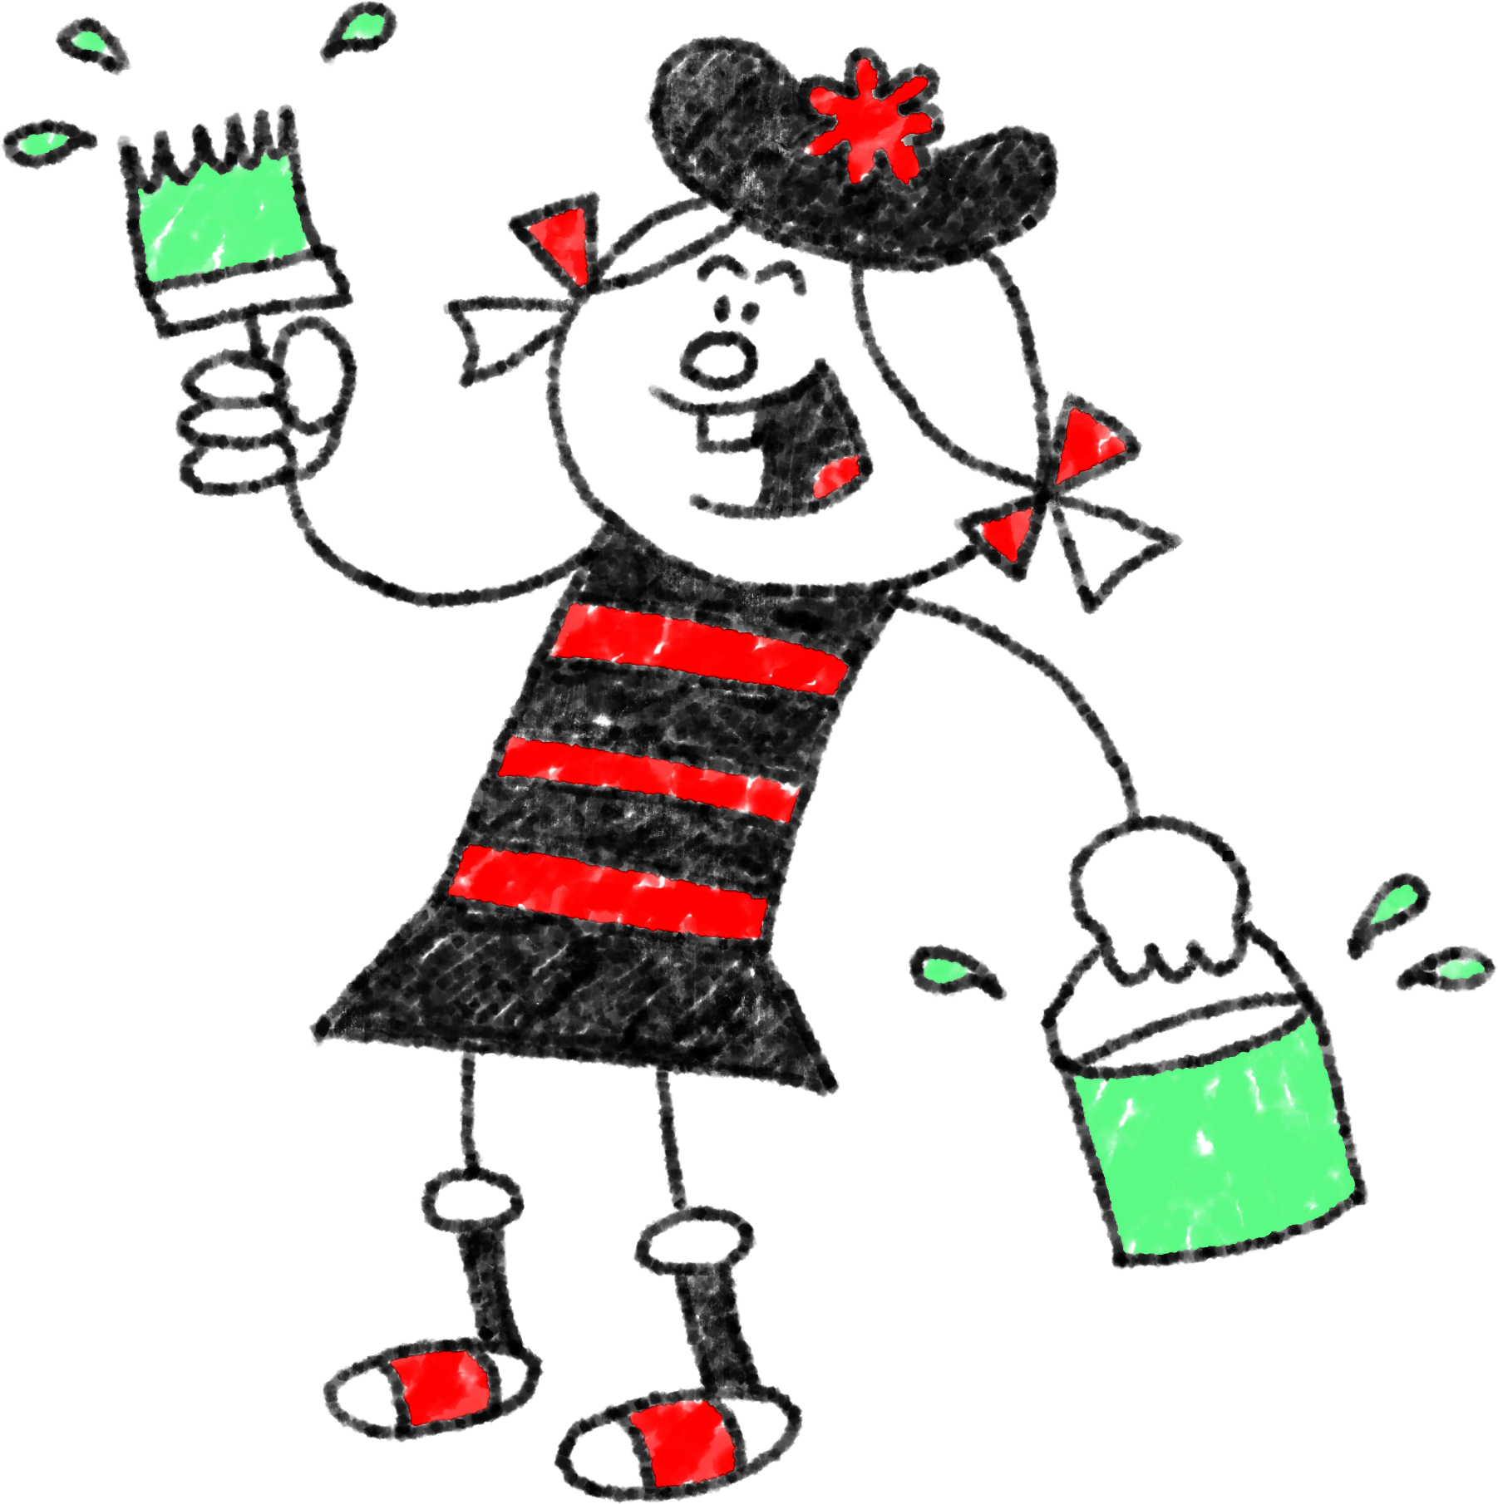
By saving our food from the bin, we can
Reduce our impact on the planet
Stop filling landfill
And even save ourselves some money
Make it Min-tastic!
You poster must
Tell people to save their food from the bin
Try to give at least one reason why
Be bold and eye-catching

Slide 18
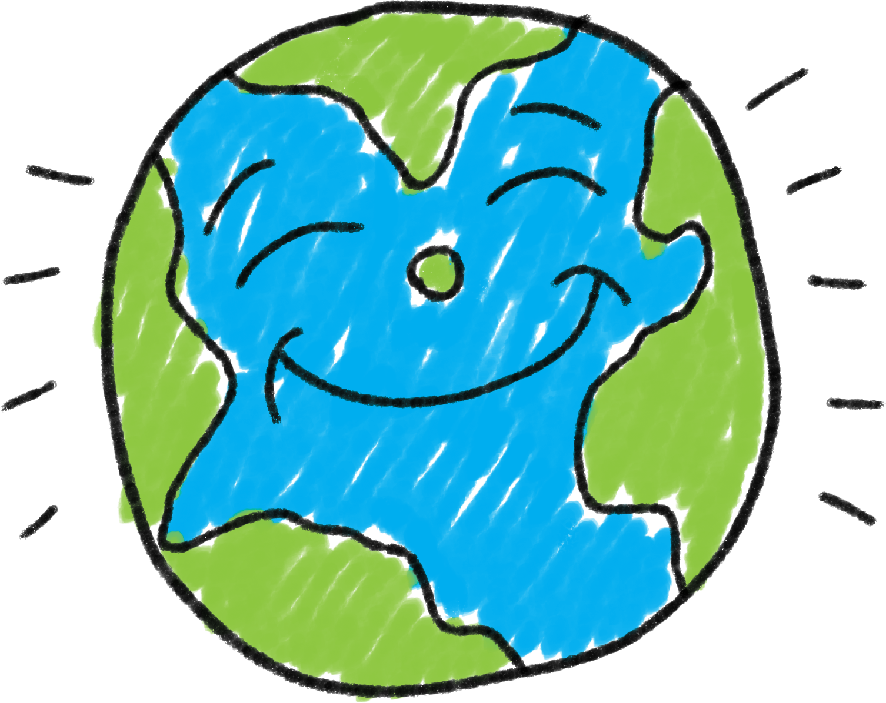

PLENARY
Let’s walk round the tables and share the
brilliant posters we have made.
Food waste has a huge impact on the planet.
But this is something we have the power to change.
The power is yours!

Slide 19
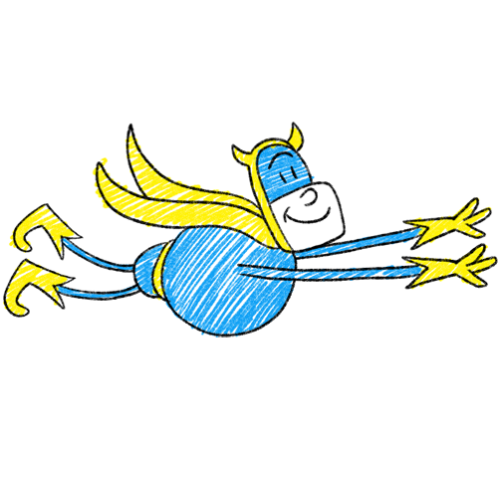
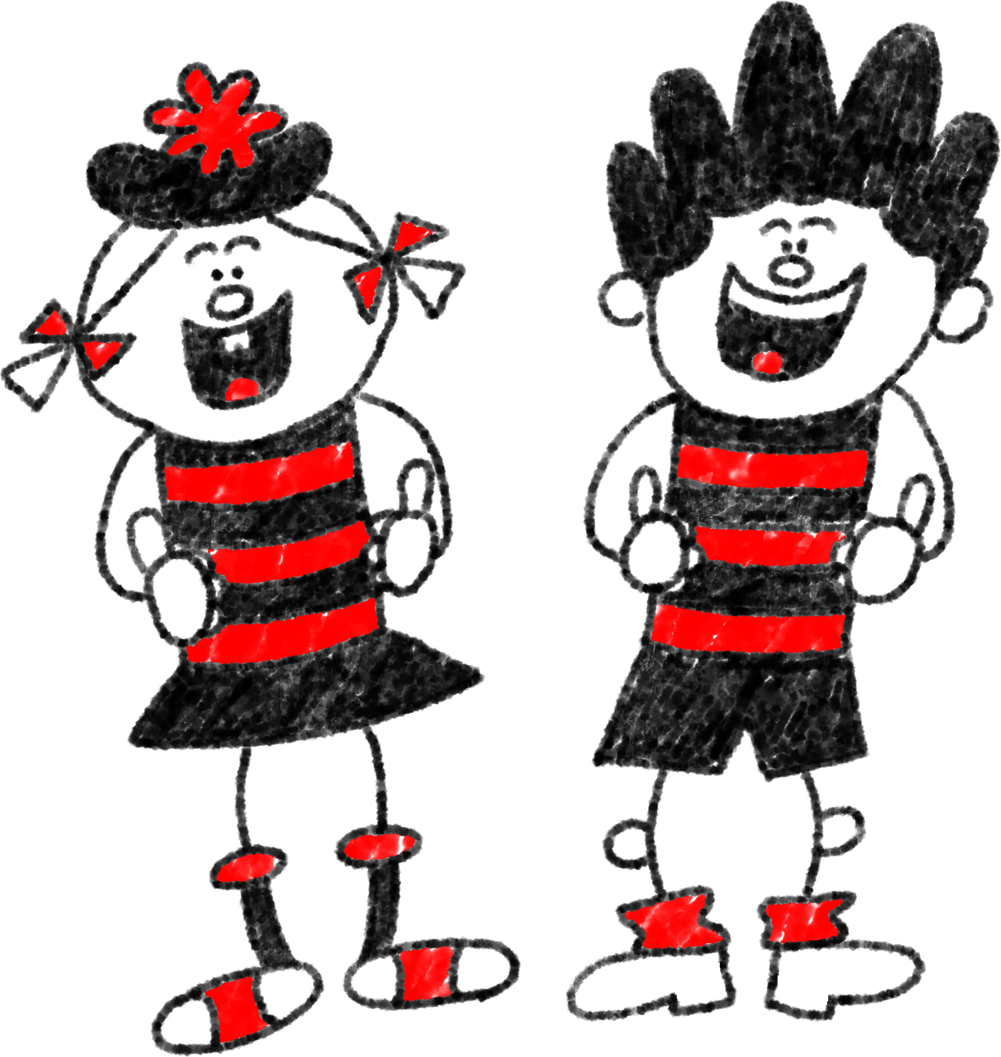
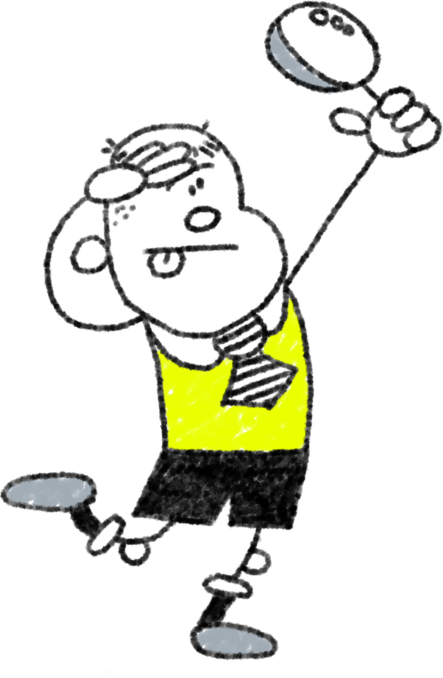
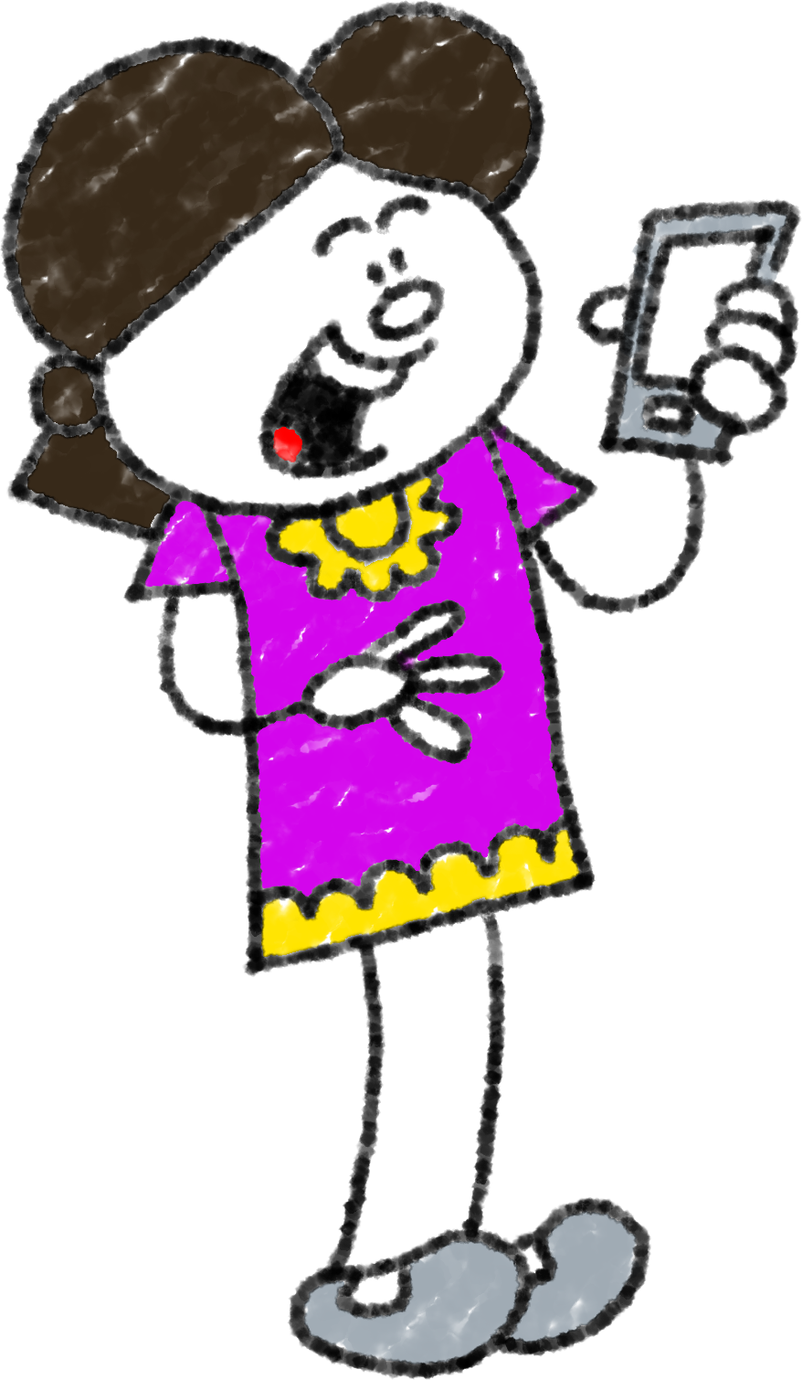
Those are some really a-Peel-ing posters!
Be a winner…
…don’t bin your dinner!
Wow! Mine’s up on Schools.Beano.com already!
I’m ready for my close-up, Ed!
Well done for spreading this important message,
Food Superheroes!

Slide 20
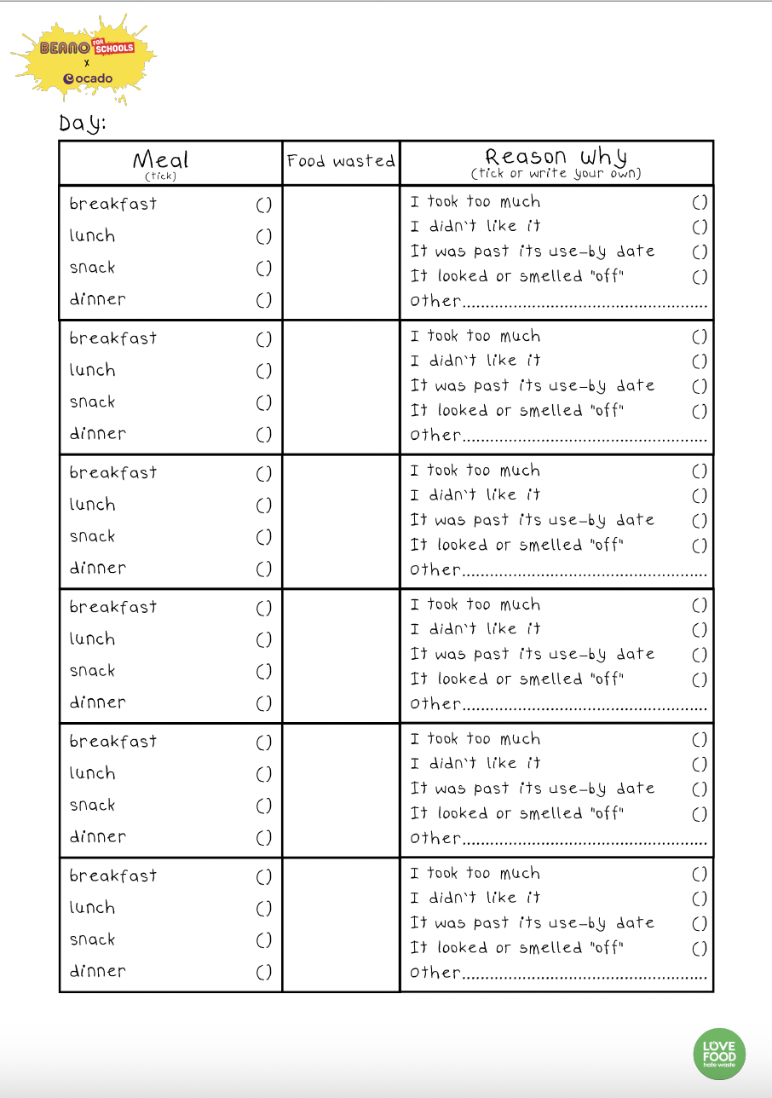
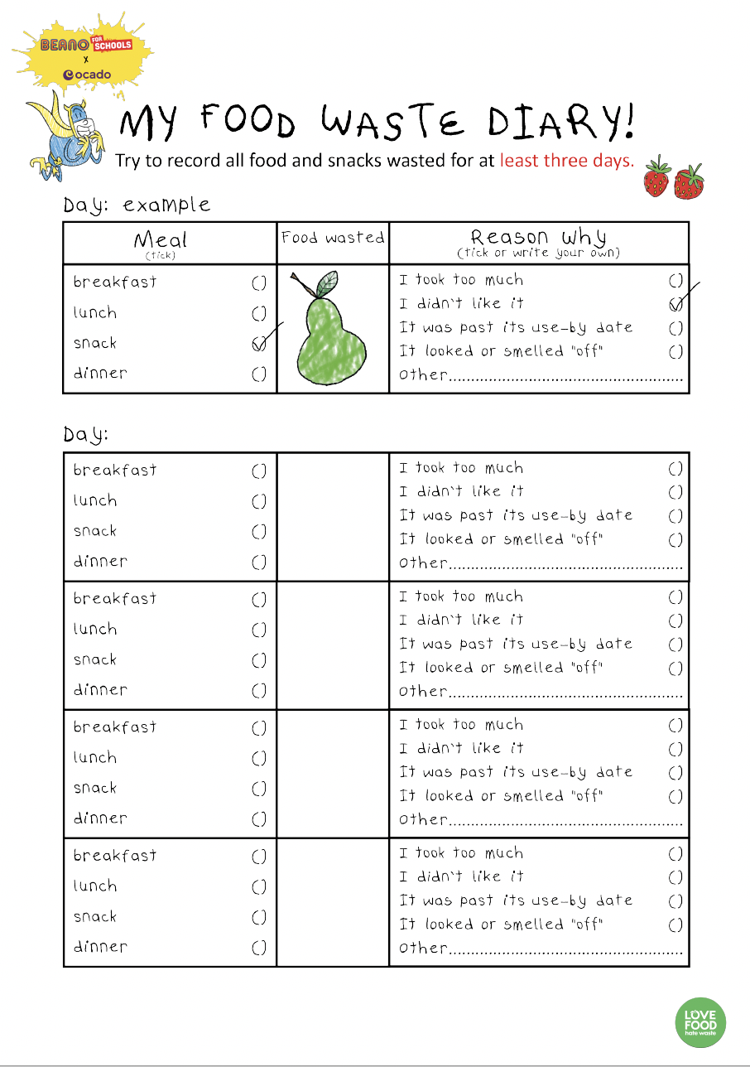
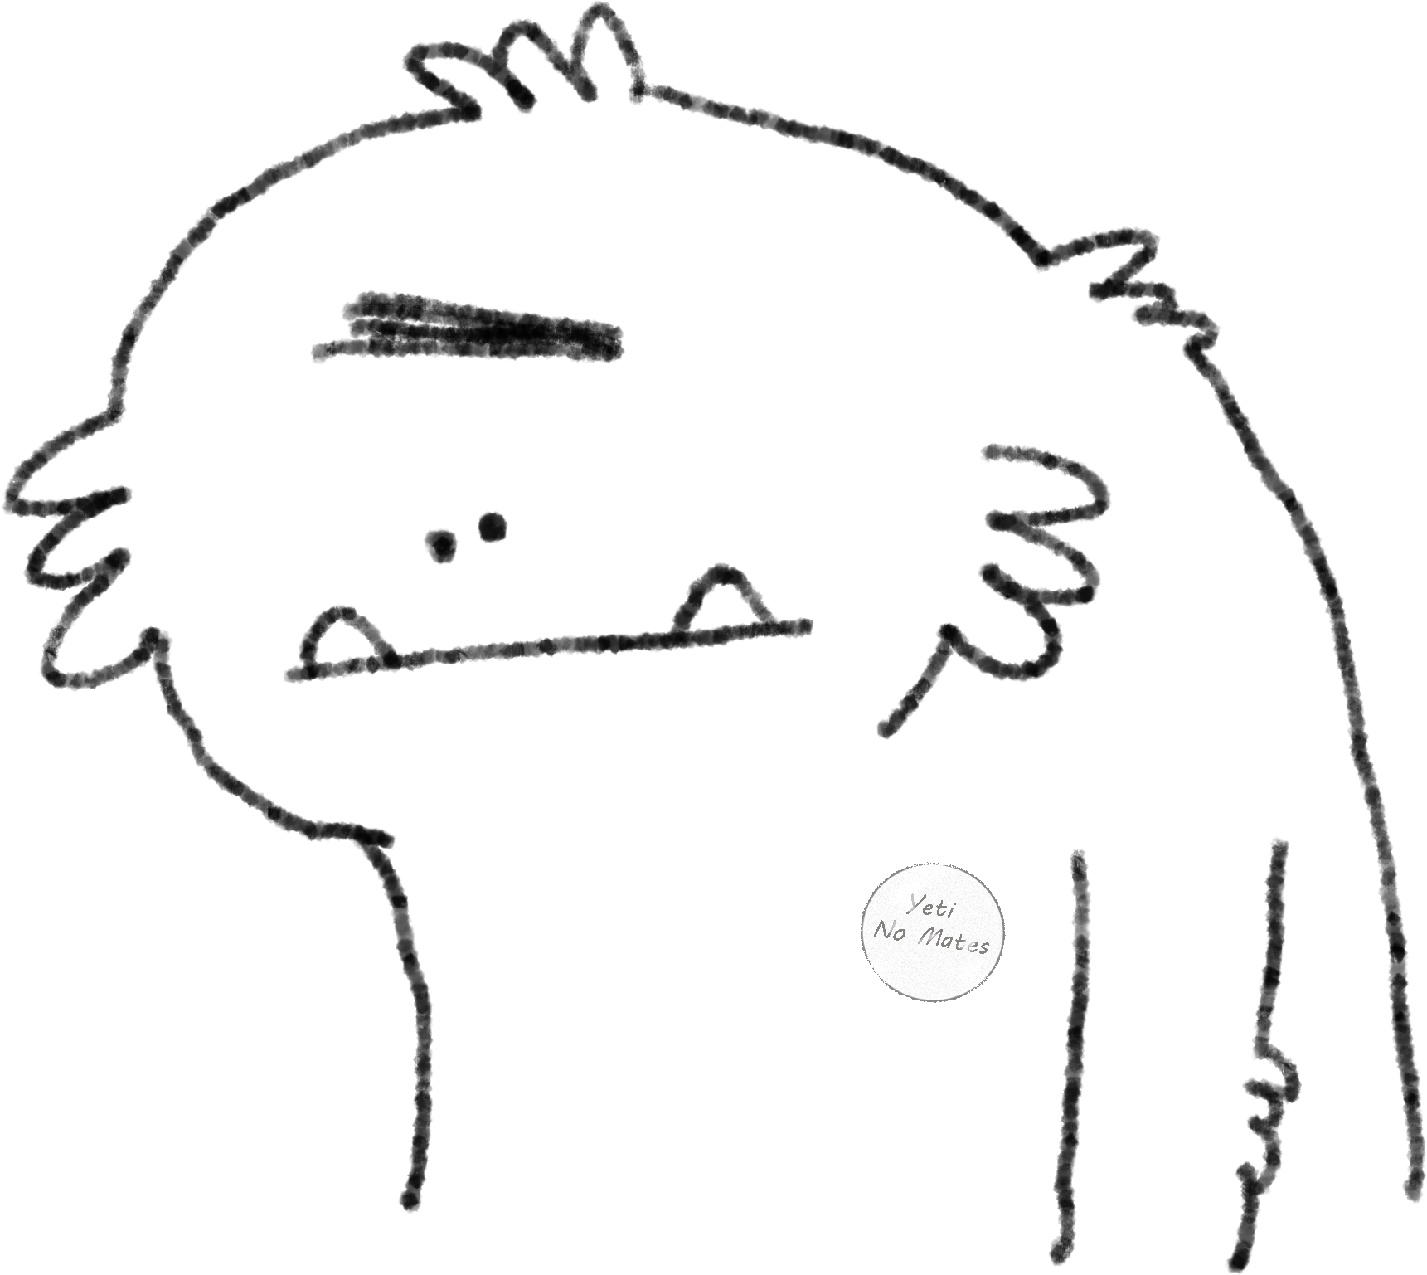
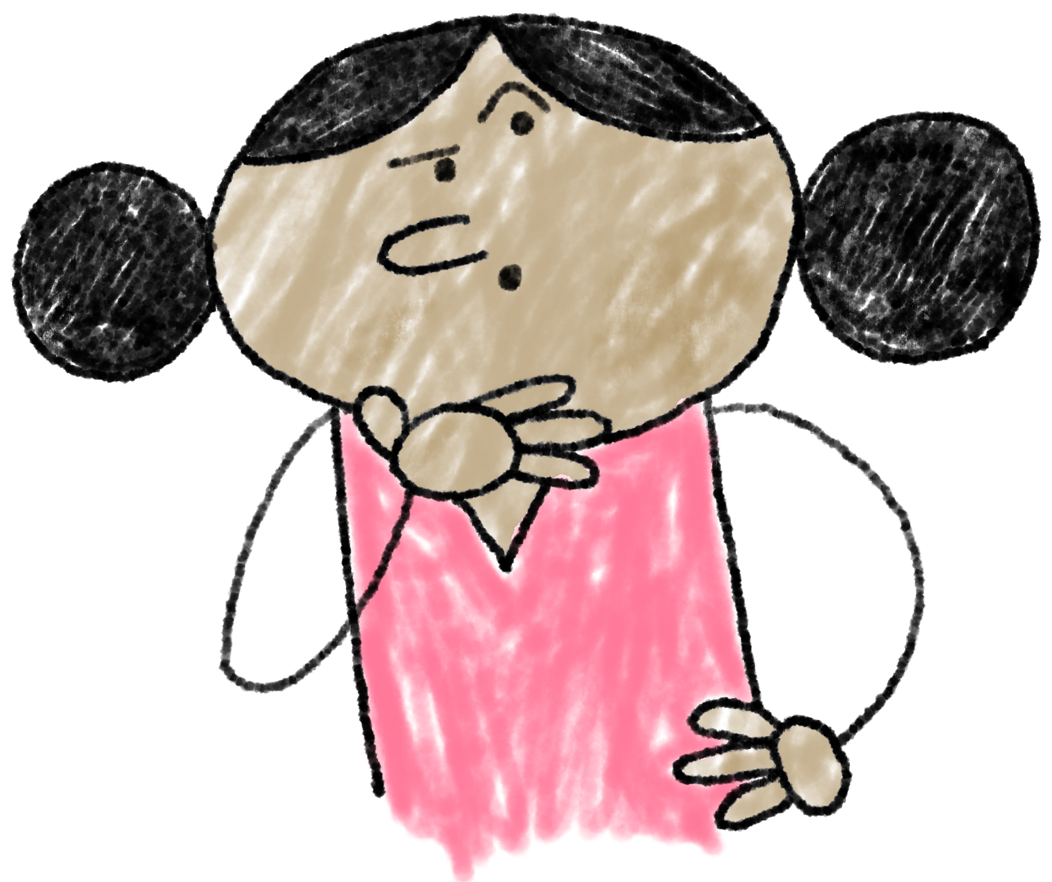
- At Home -
Let’s try to keep a
Food Waste Diary
It is helpful to think about how much food we are throwing away and why we are throwing it away so that we can all be Food Superheroes and make some positive changes!
Those who want to can share their diaries in our next lesson.
We will try to record:
WHAT: All meals and snacks – what types of food we are throwing away?
WHY: Did we take too much? Was it past its use-by date?
Or maybe someone’s cooking is just really bad?
Aww…

